Slide 1

Machine Learning
Dr. Abbas Malekpour

Slide 2

Type of Variables

Slide 3

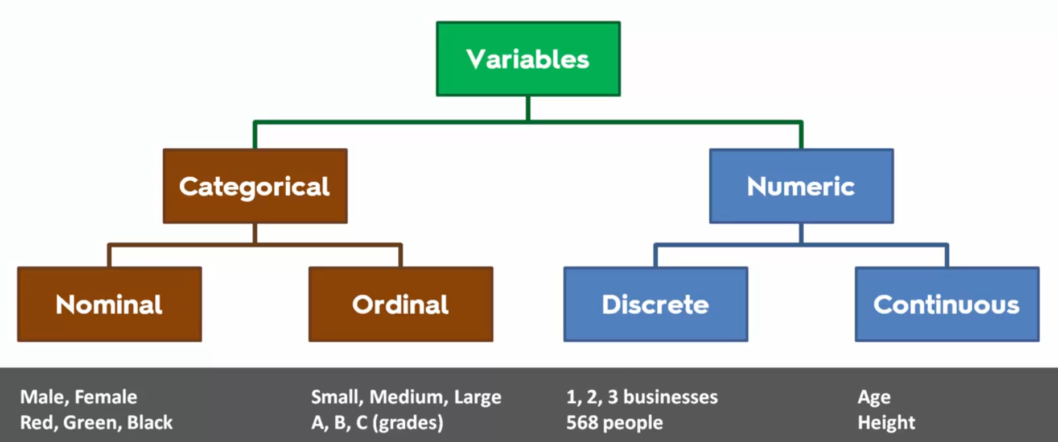
Type of Variables
Numerical and Categorical
Notes:
Target variable is Dependent Variable
All other features or variables are Independent variables

Slide 4
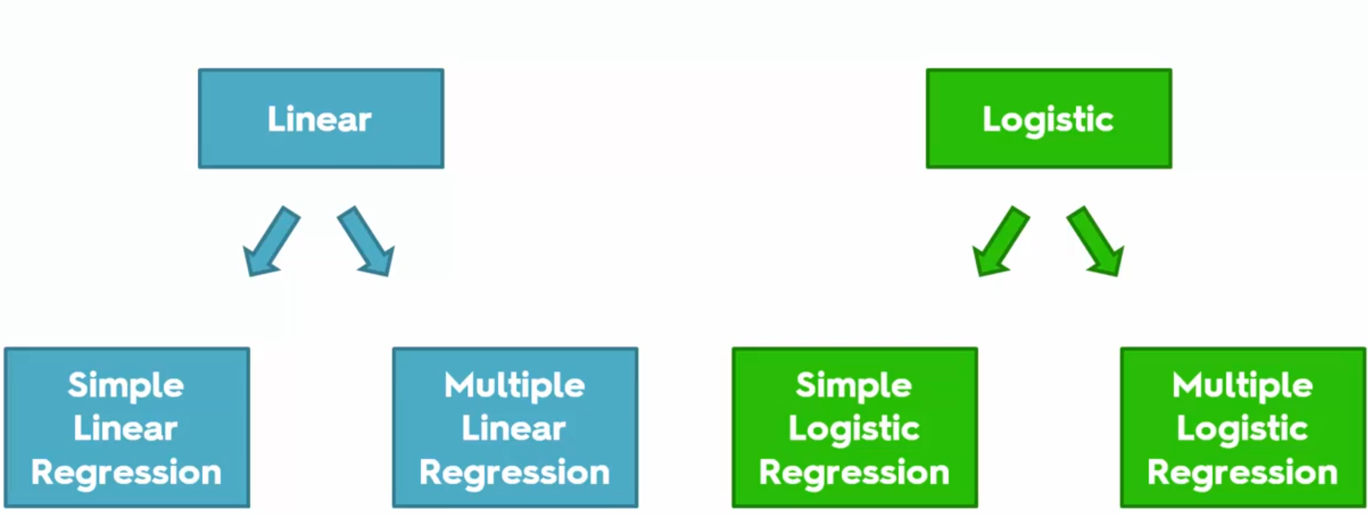
Regressions
Linear vs Logistic

Slide 6
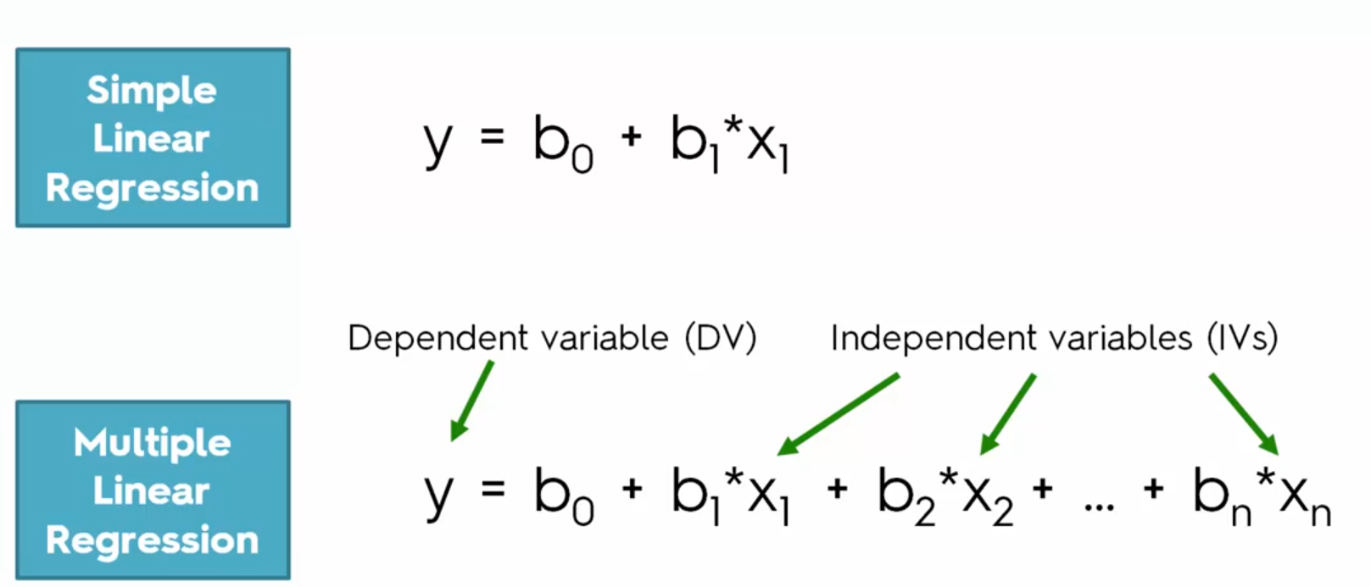
Equations
Simple vs Multiple Linear Regression

Slide 7
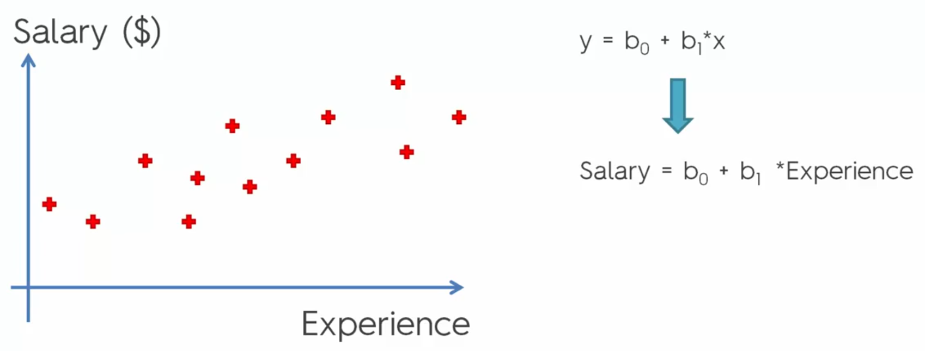
Simple Linear Regression
Salary and Experience

Slide 8
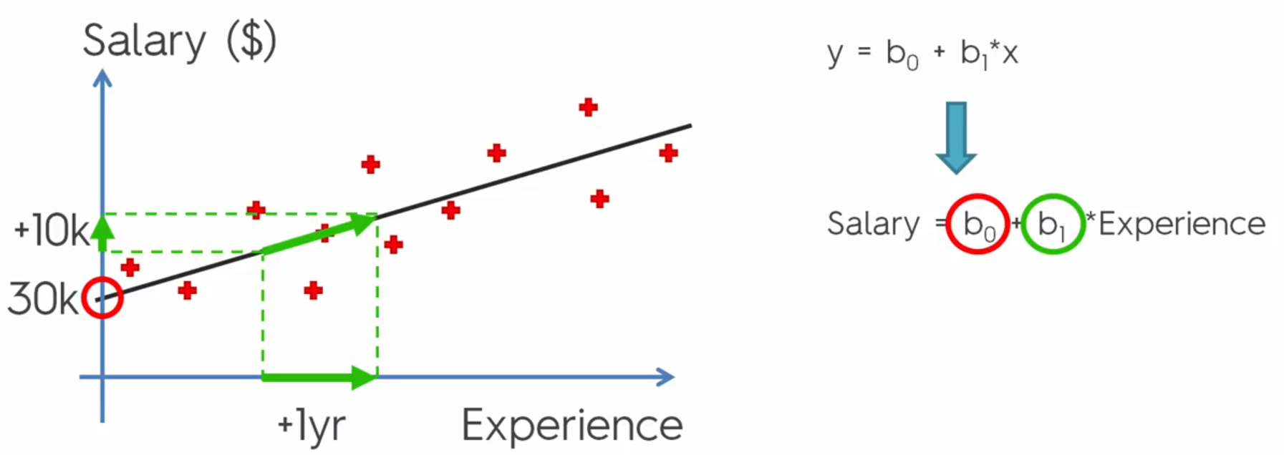
Simple Linear Regression – Continue
Linear Algebra
Notes:
B0 is Bias, B1 is the slop of the line

Slide 9
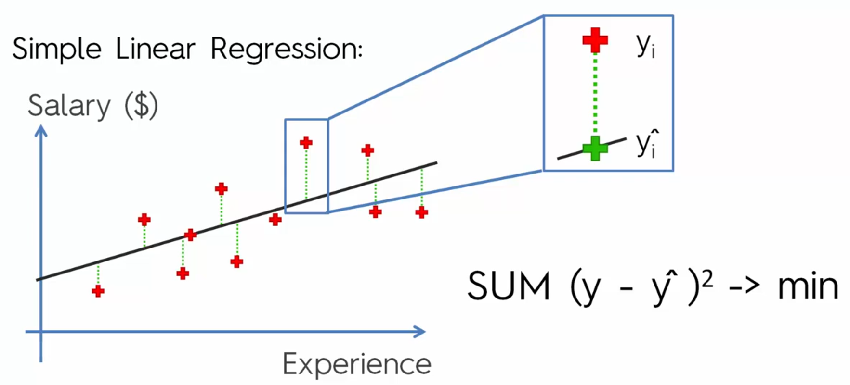
Ordinary Least Squares
Evaluation Models

Slide 10
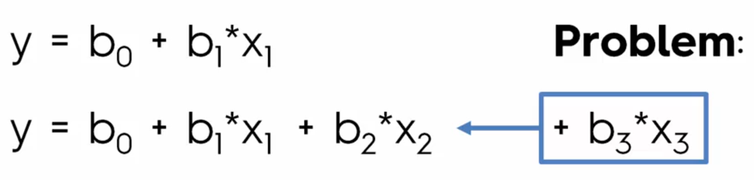
Adding Variable to reduce the ERROR rate
How many variable need to be added?

Slide 11
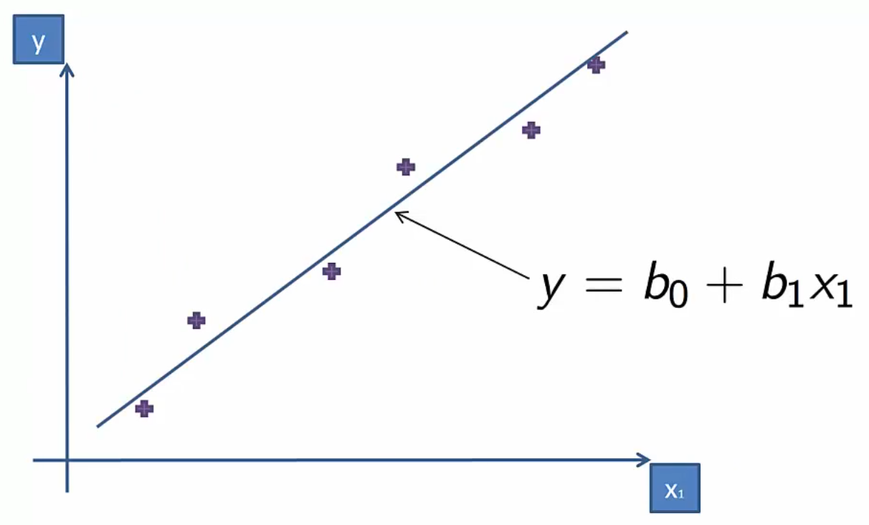
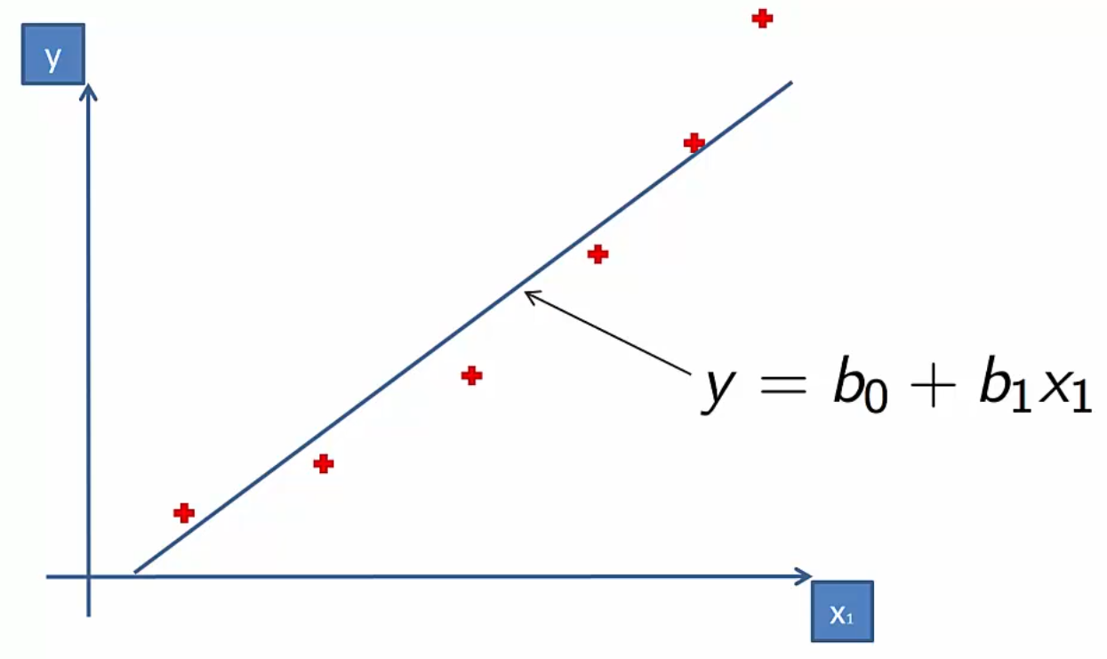
Notes:
Left fits well <> right does not fits well

Slide 12
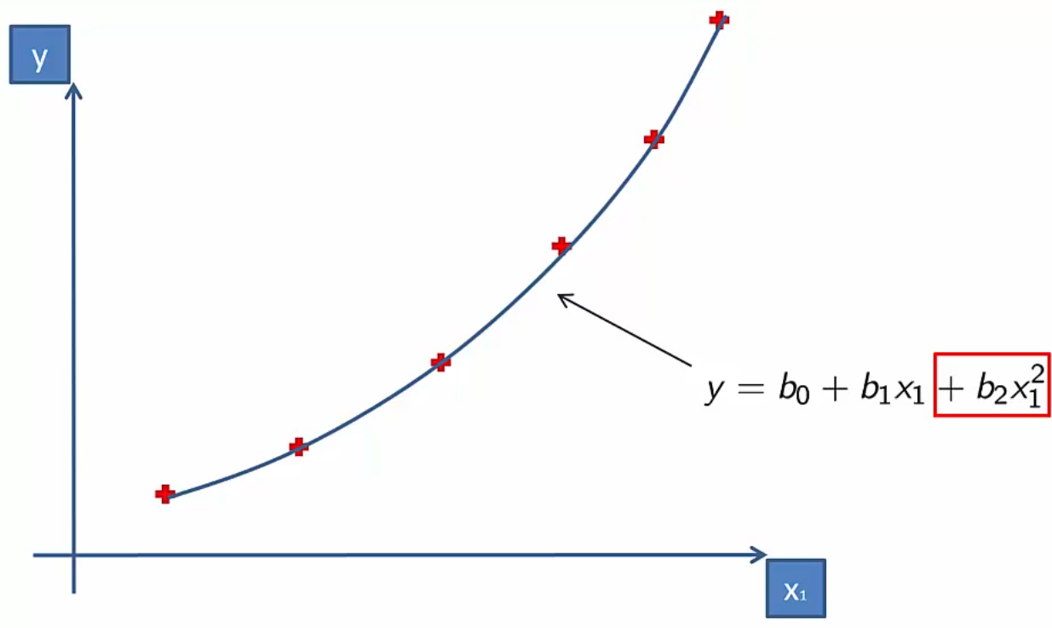
Why is called Linear?
Notes:
Coefficients are Linear!!

Slide 13
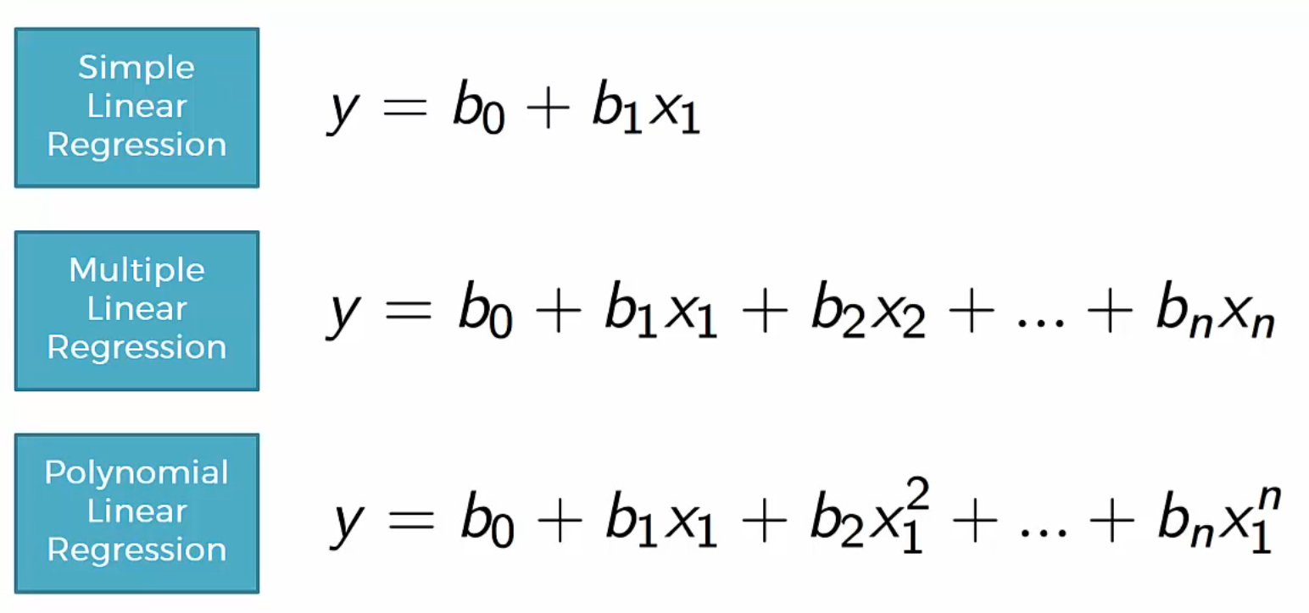
Single and Multi Variable vs Polynomial Linear Regression

Slide 14
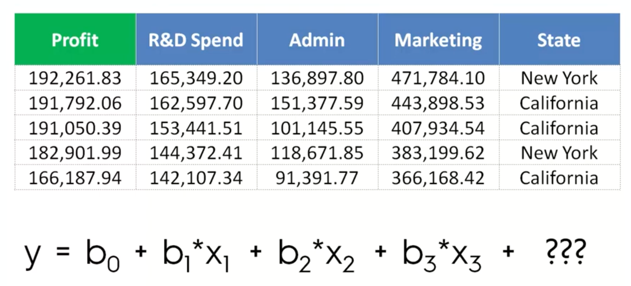

Slide 15
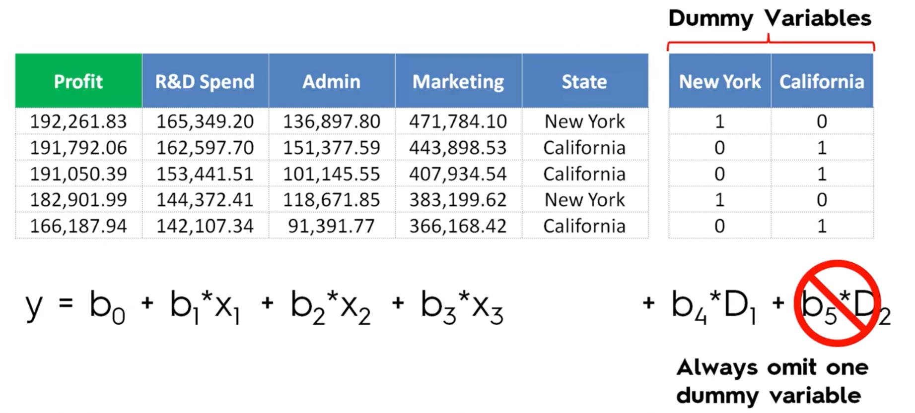
D1=1-D2 Multi-Colinearity

Slide 16
SVM – Support Vector Machine
Notes:
Non linear but continues model

Slide 17
Linear Classifiers
a
x
f
y^{est}
f(x,w,b) = sign(w. x - b)
denotes +1
denotes -1
How would you classify this data?

Slide 18
Linear Classifiers
a
x
f
y^{est}
f(x,w,b) = sign(w. x - b)
denotes +1
denotes -1
How would you classify this data?

Slide 19
Linear Classifiers
a
x
f
y^{est}
f(x,w,b) = sign(w. x - b)
denotes +1
denotes -1
How would you classify this data?

Slide 20
Linear Classifiers
a
x
f
y^{est}
f(x,w,b) = sign(w. x - b)
denotes +1
denotes -1
How would you classify this data?

Slide 21
Linear Classifiers
a
x
f
y^{est}
f(x,w,b) = sign(w. x - b)
denotes +1
denotes -1
Any of these would be fine..
..but which is best?

Slide 22
Classifier Margin
a
x
f
y^{est}
f(x,w,b) = sign(w. x - b)
denotes +1
denotes -1
Define the margin of a linear classifier as the width that the boundary could be increased by before hitting a datapoint.

Slide 23
Maximum Margin
a
x
f
y^{est}
f(x,w,b) = sign(w. x - b)
denotes +1
denotes -1
The maximum margin linear classifier is the linear classifier with the, um, maximum margin.
This is the simplest kind of SVM (Called an LSVM)
Linear SVM

Slide 24
Maximum Margin
a
x
f
y^{est}
f(x,w,b) = sign(w. x - b)
denotes +1
denotes -1
The maximum margin linear classifier is the linear classifier with the, um, maximum margin.
This is the simplest kind of SVM (Called an LSVM)
Support Vectors are those datapoints that the margin pushes up against
Linear SVM

Slide 25
Why Maximum Margin?
Intuitively this feels safest.
If we’ve made a small error in the location of the boundary (it’s been jolted in its perpendicular direction) this gives us least chance of causing a misclassification.
LOOCV is easy since the model is immune to removal of any non-support-vector datapoints.
There’s some theory (using VC dimension) that is related to (but not the same as) the proposition that this is a good thing.
Empirically it works very very well.
f(x,w,b) = sign(w. x - b)
denotes +1
denotes -1
The maximum margin linear classifier is the linear classifier with the, um, maximum margin.
This is the simplest kind of SVM (Called an LSVM)
Support Vectors are those datapoints that the margin pushes up against

Slide 26
Specifying a line and margin
Plus-Plane
“Predict Class = +1” zone
Classifier Boundary
Minus-Plane
“Predict Class = -1” zone
How do we represent this mathematically?
…in m input dimensions?

Slide 27
Specifying a line and margin
Plus-Plane
“Predict Class = +1” zone
Classifier Boundary
Minus-Plane
“Predict Class = -1” zone
wx+b=1
wx+b=0
wx+b=-1
Plus-plane = { x : w . x + b = +1 }
Minus-plane = { x : w . x + b = -1 }
Classify as.. | +1 | if | w . x + b >= 1
 | -1 | if | w . x + b <= -1
 | Universe explodes | if | -1 < w . x + b < 1

Slide 28
Computing the margin width
M = Margin Width
“Predict Class = +1” zone
How do we compute M in terms of w and b?
“Predict Class = -1” zone
wx+b=1
wx+b=0
wx+b=-1
Plus-plane = { x : w . x + b = +1 }
Minus-plane = { x : w . x + b = -1 }
Claim: The vector w is perpendicular to the Plus Plane. Why?

Slide 29
Computing the margin width
M = Margin Width
“Predict Class = +1” zone
How do we compute M in terms of w and b?
“Predict Class = -1” zone
wx+b=1
wx+b=0
wx+b=-1
Plus-plane = { x : w . x + b = +1 }
Minus-plane = { x : w . x + b = -1 }
Claim: The vector w is perpendicular to the Plus Plane. Why?
Let u and v be two vectors on the Plus Plane. What is w . ( u – v ) ?
And so of course the vector w is also perpendicular to the Minus Plane

Slide 30
Computing the margin width
x⁺
M = Margin Width
“Predict Class = +1” zone
How do we compute M in terms of w and b?
x⁻
“Predict Class = -1” zone
wx+b=1
wx+b=0
wx+b=-1
Plus-plane = { x : w . x + b = +1 }
Minus-plane = { x : w . x + b = -1 }
The vector w is perpendicular to the Plus Plane
Let x⁻ be any point on the minus plane
Let x⁺ be the closest plus-plane-point to x⁻.
Any location in Â^{m}: not necessarily a datapoint
Any location in R^{m}: not necessarily a datapoint

Slide 31
Computing the margin width
x⁺
M = Margin Width
“Predict Class = +1” zone
How do we compute M in terms of w and b?
x⁻
“Predict Class = -1” zone
wx+b=1
wx+b=0
wx+b=-1
Plus-plane = { x : w . x + b = +1 }
Minus-plane = { x : w . x + b = -1 }
The vector w is perpendicular to the Plus Plane
Let x⁻ be any point on the minus plane
Let x⁺ be the closest plus-plane-point to x⁻.
Claim: x⁺ = x⁻ + λ w for some value of λ. Why?

Slide 32
Computing the margin width
x⁺
M = Margin Width
“Predict Class = +1” zone
The line from x⁻ to x⁺ is perpendicular to the planes.
So to get from x⁻ to x⁺ travel some distance in direction w.
How do we compute M in terms of w and b?
x⁻
“Predict Class = -1” zone
wx+b=1
wx+b=0
wx+b=-1
Plus-plane = { x : w . x + b = +1 }
Minus-plane = { x : w . x + b = -1 }
The vector w is perpendicular to the Plus Plane
Let x⁻ be any point on the minus plane
Let x⁺ be the closest plus-plane-point to x⁻.
Claim: x⁺ = x⁻ + λ w for some value of λ. Why?

Slide 33
Computing the margin width
x⁺
M = Margin Width
“Predict Class = +1” zone
x⁻
“Predict Class = -1” zone
wx+b=1
wx+b=0
wx+b=-1
What we know:
w . x⁺ + b = +1
w . x⁻ + b = -1
x⁺ = x⁻ + λ w
|x⁺ - x⁻ | = M
It’s now easy to get M in terms of w and b

Slide 34
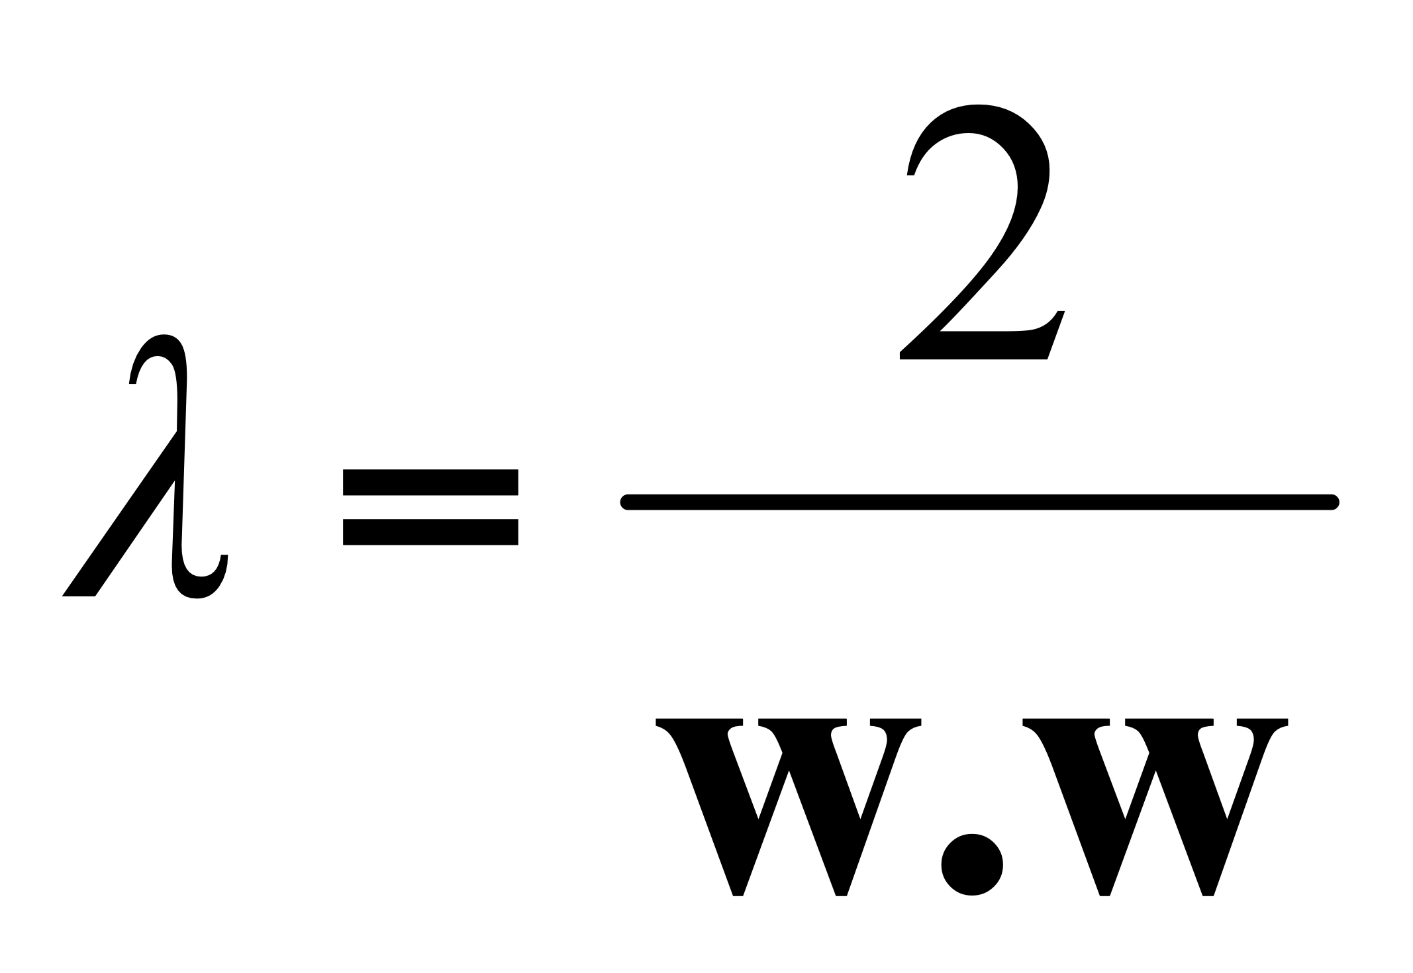
Computing the margin width
x⁺
M = Margin Width
“Predict Class = +1” zone
x⁻
“Predict Class = -1” zone
wx+b=1
wx+b=0
w . (x ⁻ + λ w) + b = 1
=>
w . x ⁻ + b + λ w .w = 1
=>
-1 + λ w .w = 1
=>
wx+b=-1
What we know:
w . x⁺ + b = +1
w . x⁻ + b = -1
x⁺ = x⁻ + λ w
|x⁺ - x⁻ | = M
It’s now easy to get M in terms of w and b

Slide 35
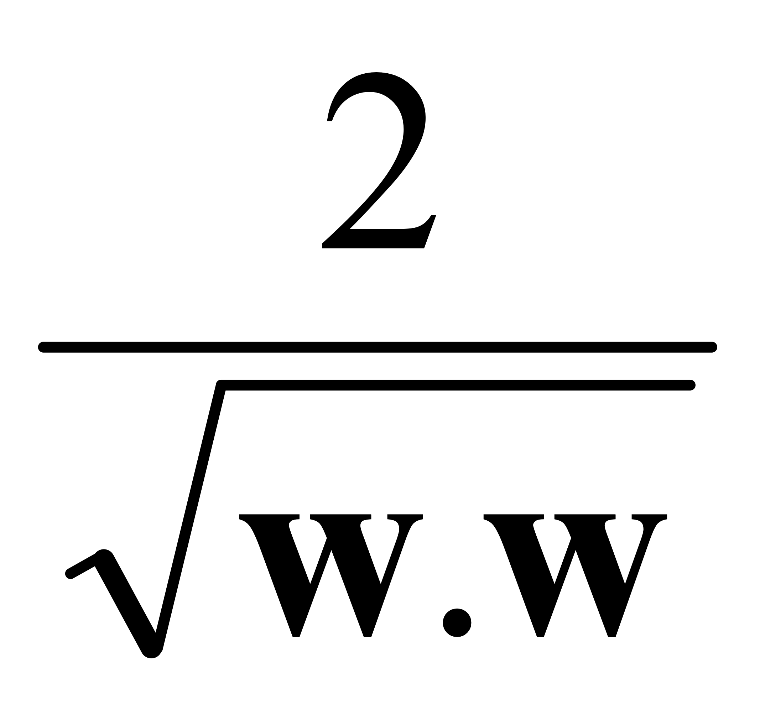
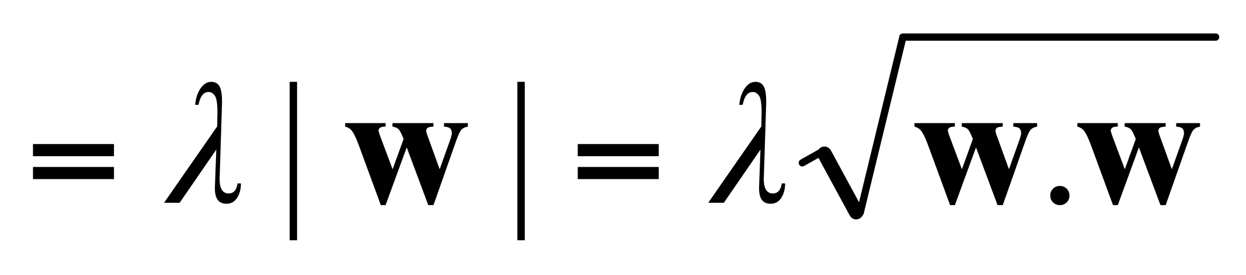
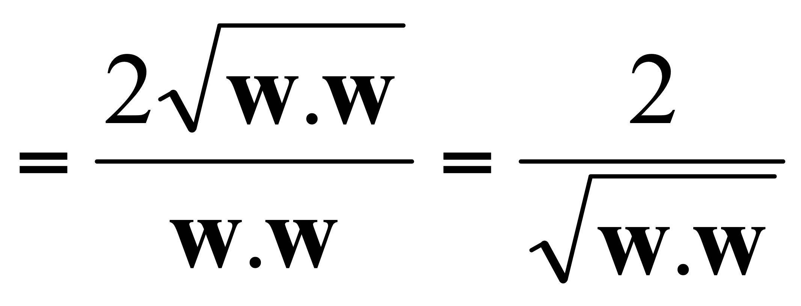
Computing the margin width
x⁺
M = Margin Width =
“Predict Class = +1” zone
x⁻
“Predict Class = -1” zone
wx+b=1
wx+b=0
M = |x⁺ - x⁻ | =| λ w |=
wx+b=-1
What we know:
w . x⁺ + b = +1
w . x⁻ + b = -1
x⁺ = x⁻ + λ w
|x⁺ - x⁻ | = M

Slide 37
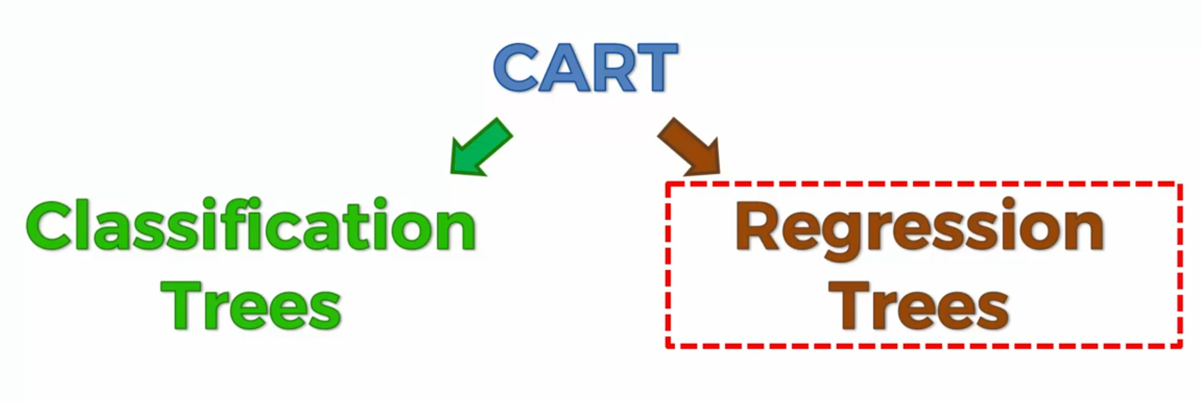
Classification and Regression Trees

Slide 38
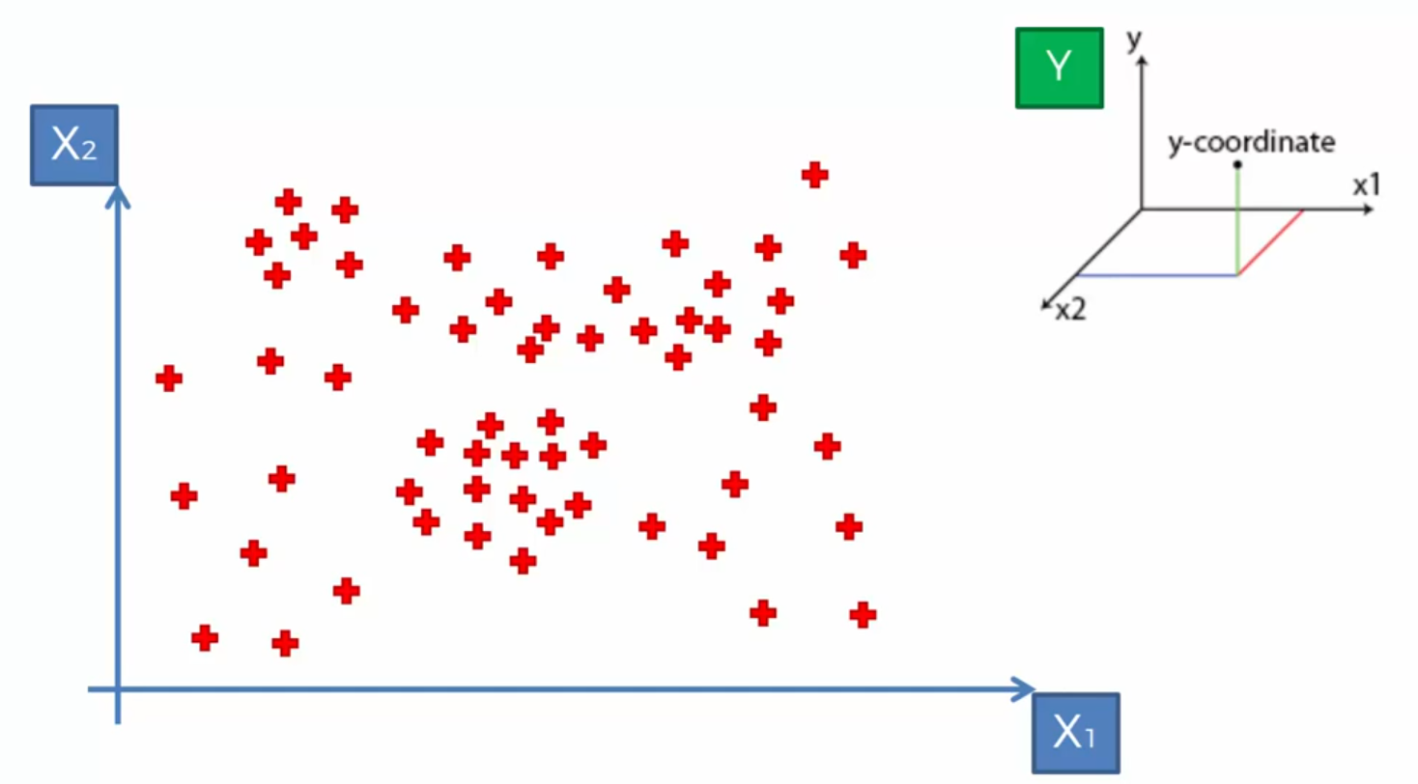
Decision Tree Intuition

Slide 39
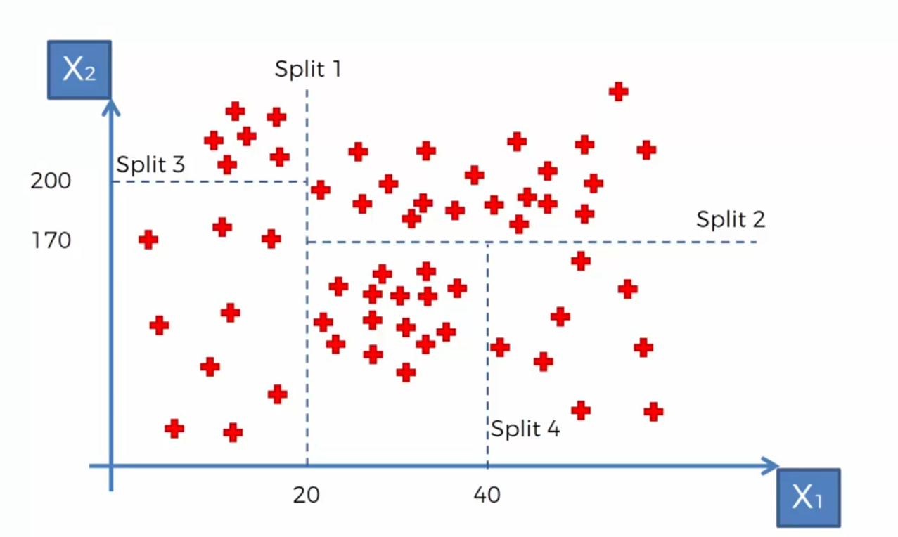
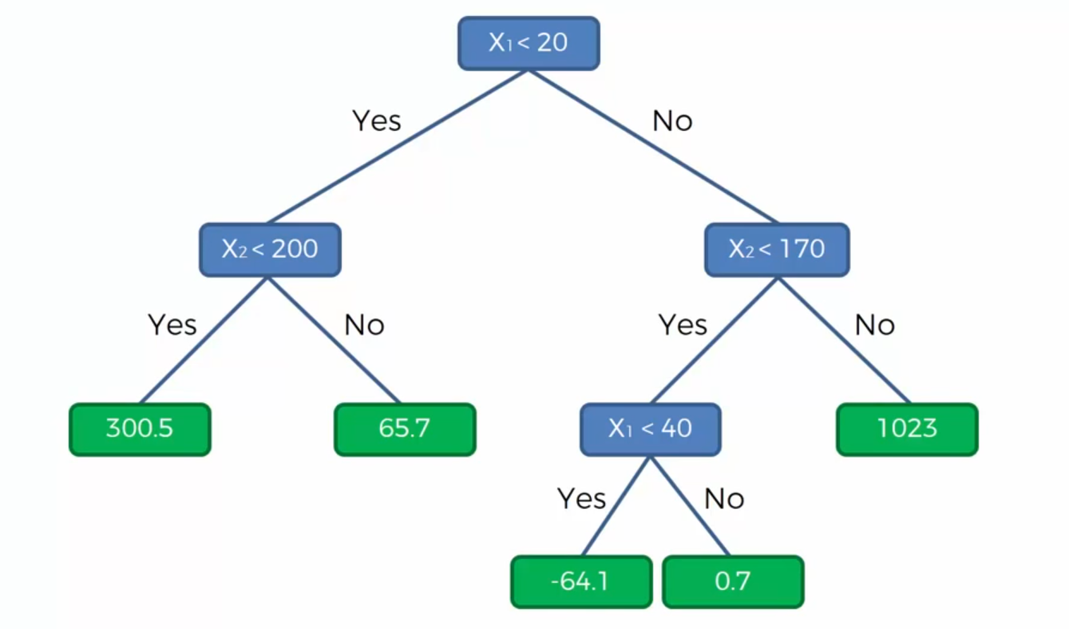
Notes:
Information Entropy… whether adding new split give us more info or not?

Slide 40
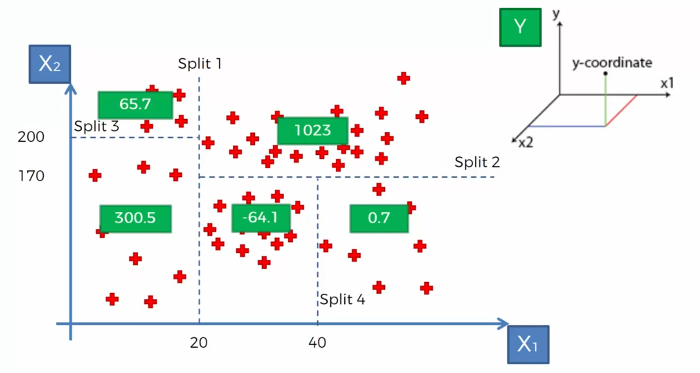
Decision Tree value for Regression models
Notes:
Non linear and not continues model

Slide 41
Decision Tree and Final output for Regression model
Notes:
Average of each partition will be the result of partition

Slide 42
Ensemble Learning
Bagging
Different independent sample
Random Forest
and for each sample you make a separate Decision Tree
Boosting
Weak learning
…

Slide 43
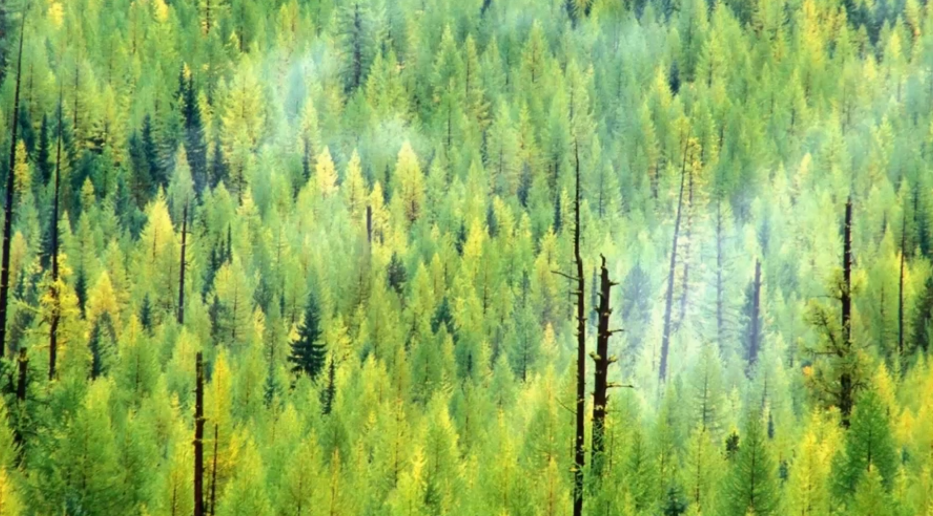

Slide 44
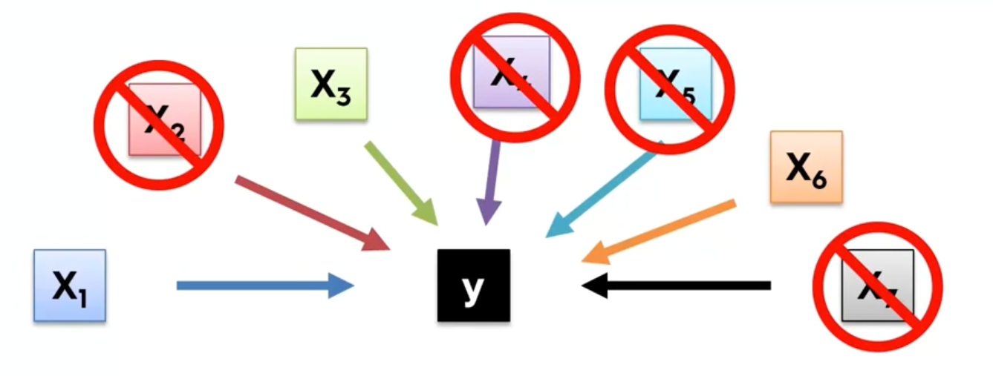
Building a Model
Why we don’t need to keep all columns?

Slide 45
Feature Scaling

Slide 46

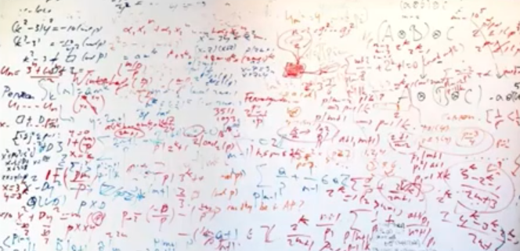
Building a Model
Why we don’t need all the Features?
Garbage in Garbage out
Complexity and confusion

Slide 47
Objectives and Overview
Predict the burned area of forest fires!
A reusable end-to-end Regression framework
EDA
Feature Selection
Feature Engineering
Training and Test Data selection
Modeling
Pipeline for each possible steps
Hyper Parameter Tuning
Evaluation

Slide 48
Classification

Slide 49
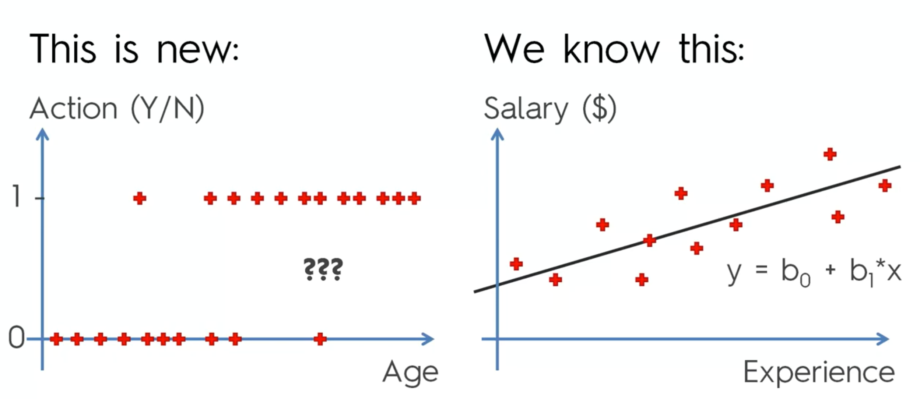
Classification

Slide 51
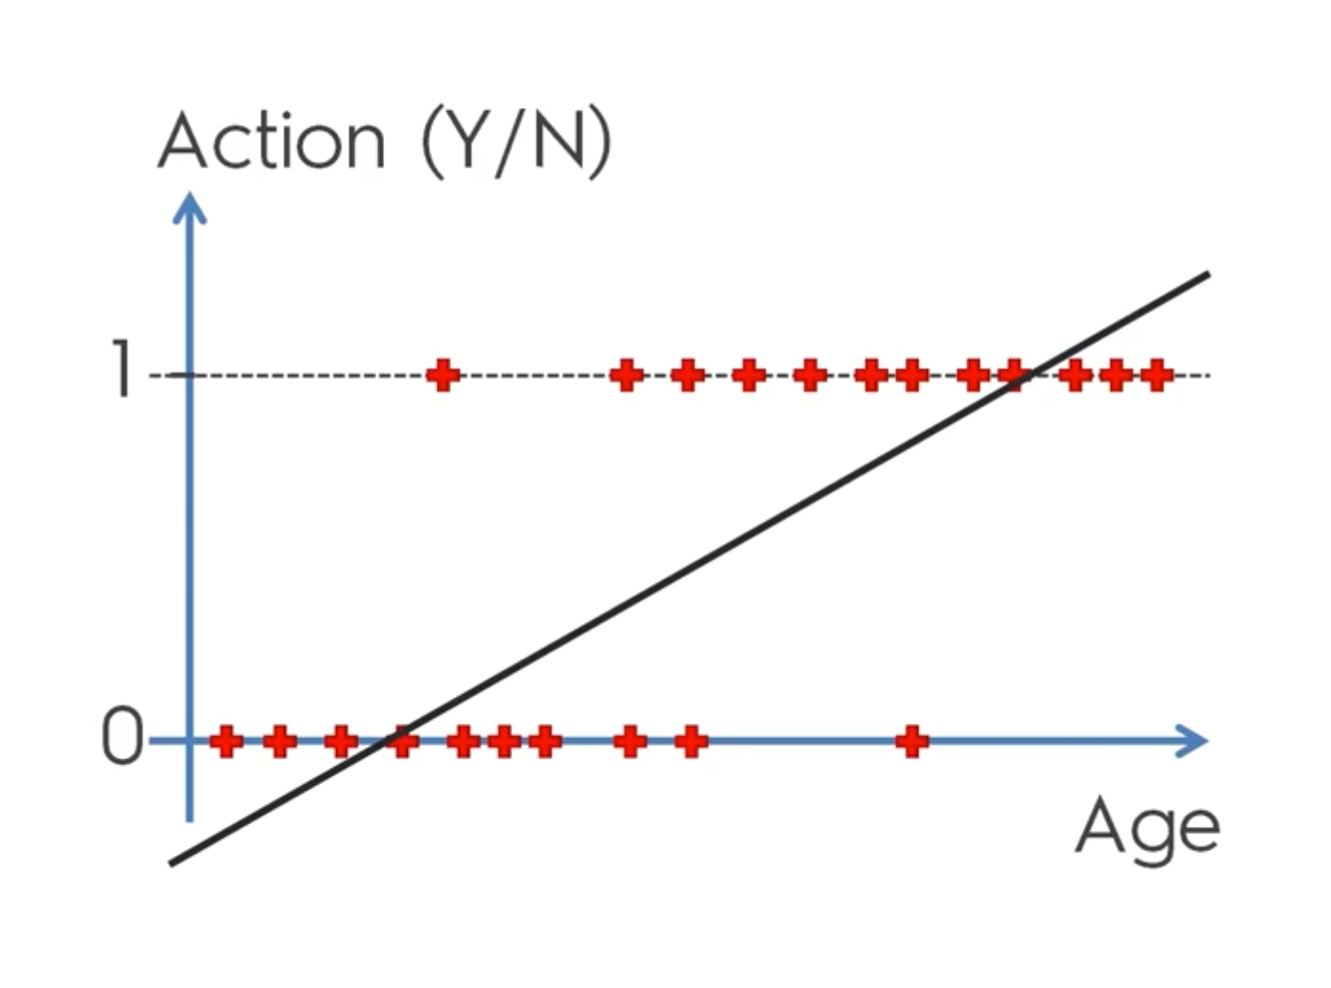

Slide 52
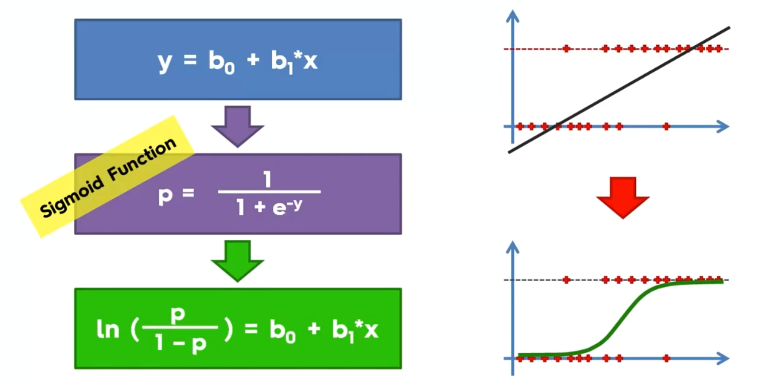
Notes:
Forget this for learning

Slide 53
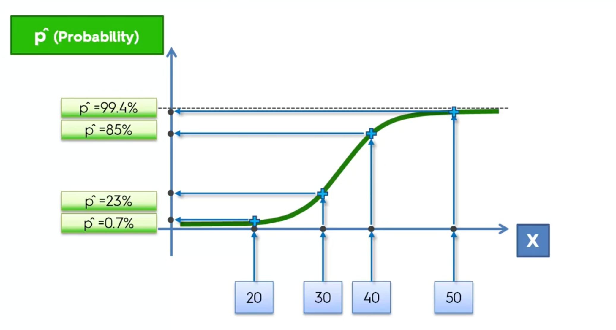

Slide 54
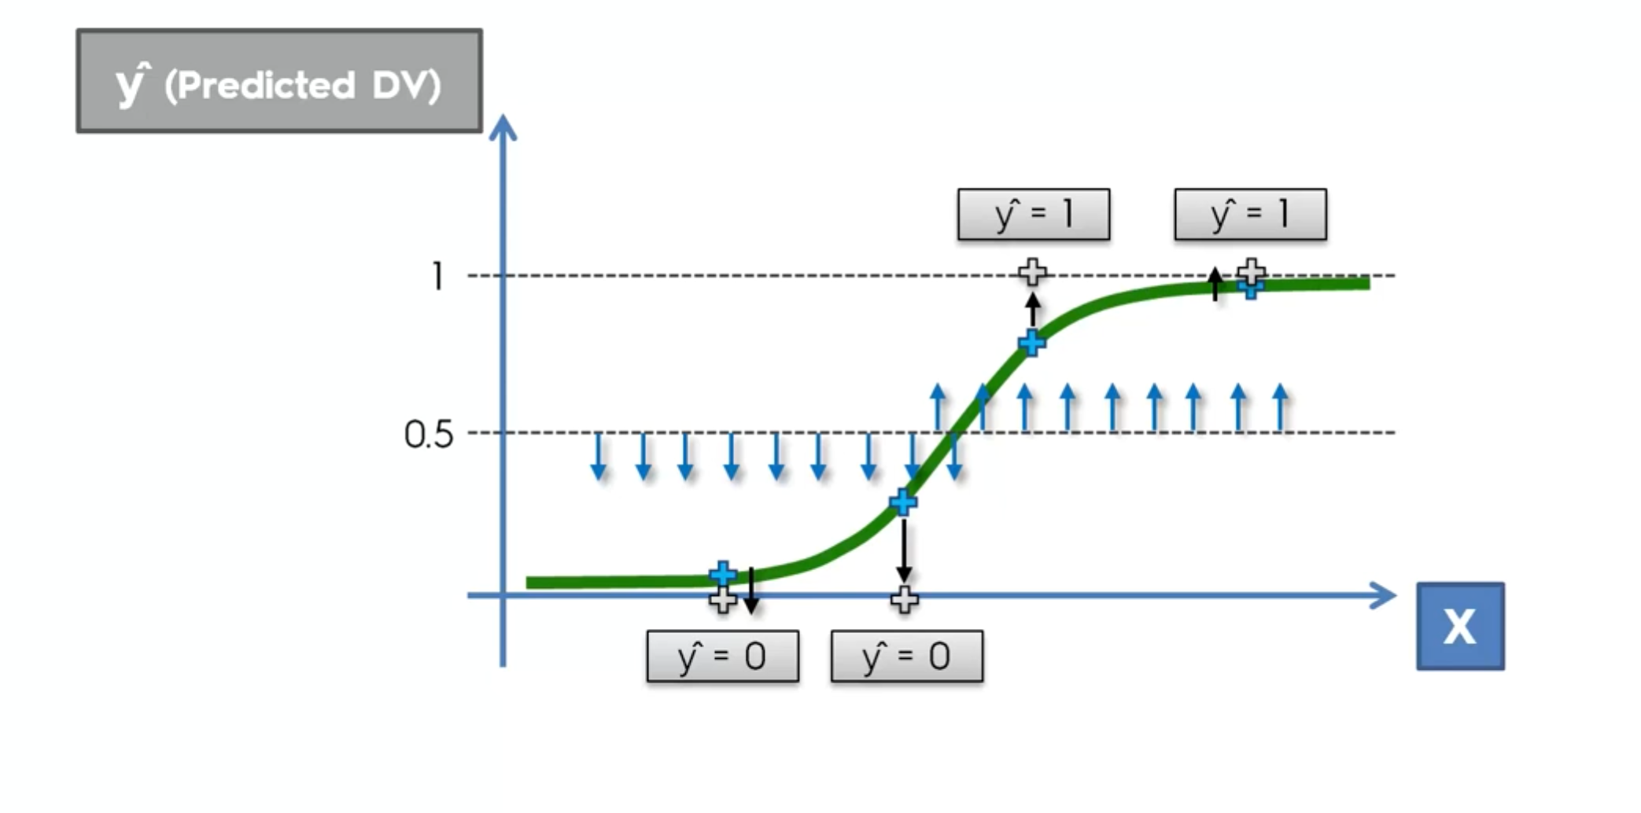

Slide 55
K-Nearest Neighbor
Choose the number K of neighbors
Take the K nearest neighbors of the new data point, according to the Euclidean distance
Among these K neighbors, count the number of data points in each category
Assign the new data pint to the category where you counted the most neighbors
Your Model is ready
Notes:
Default is 5

Slide 56
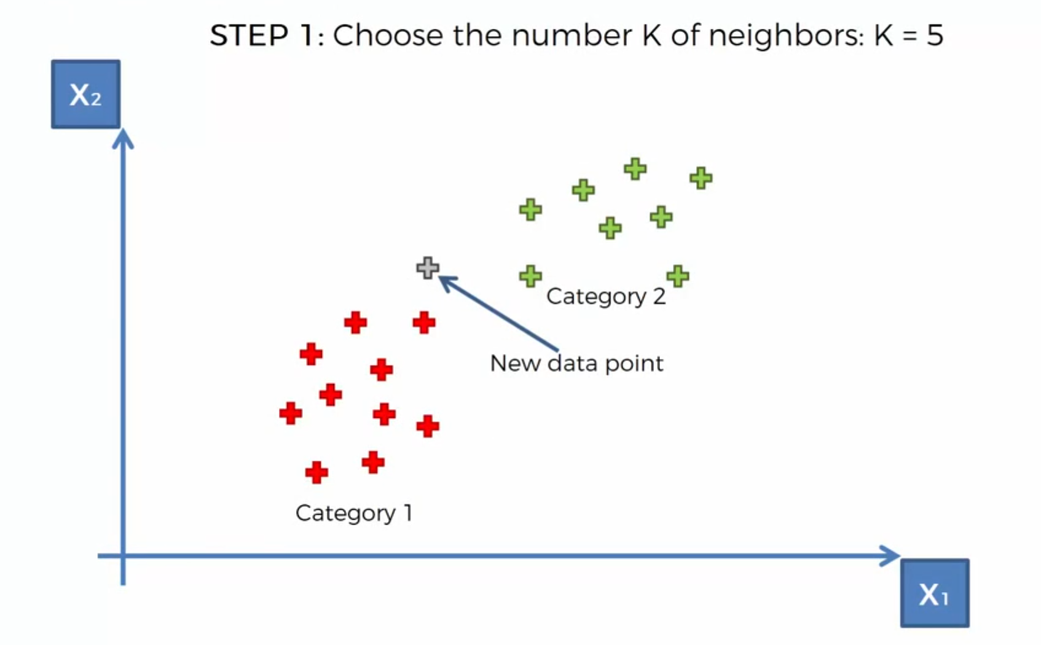
K-NN

Slide 57
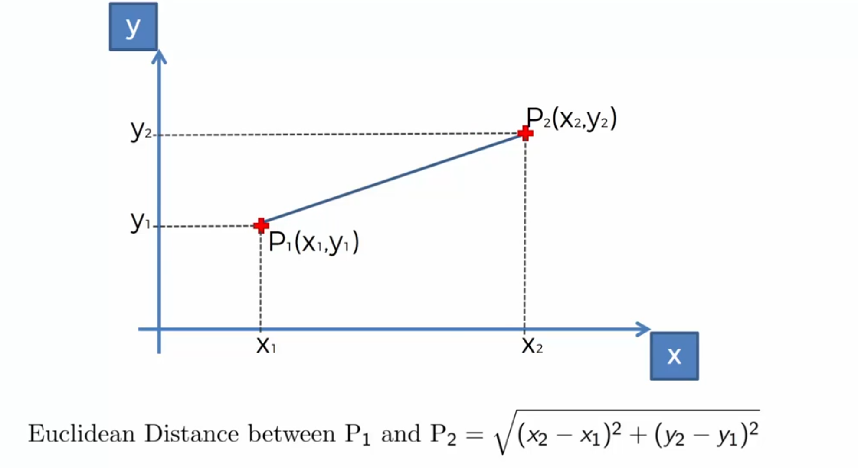

Slide 58
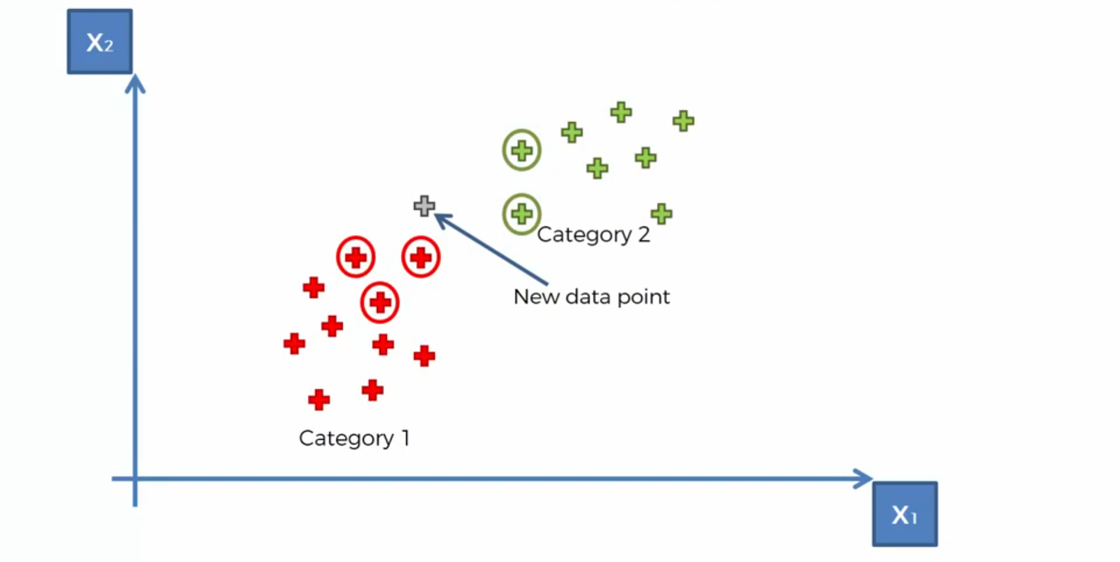
K-NN

Slide 59
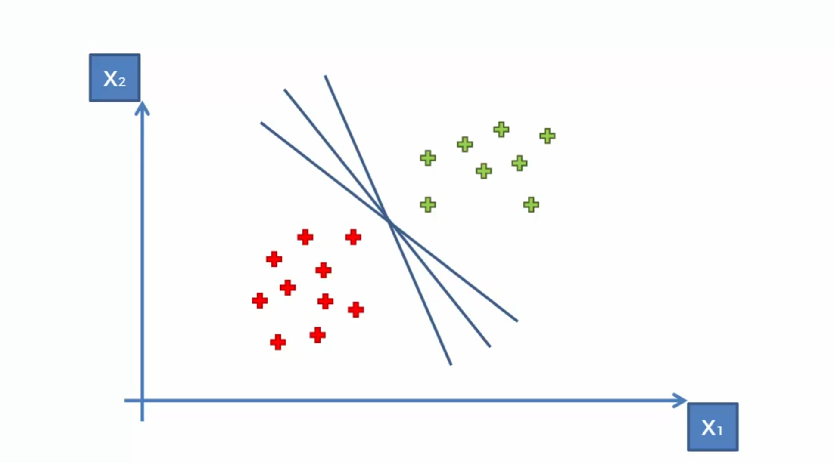
Support Vector Machine (SVM)

Slide 60
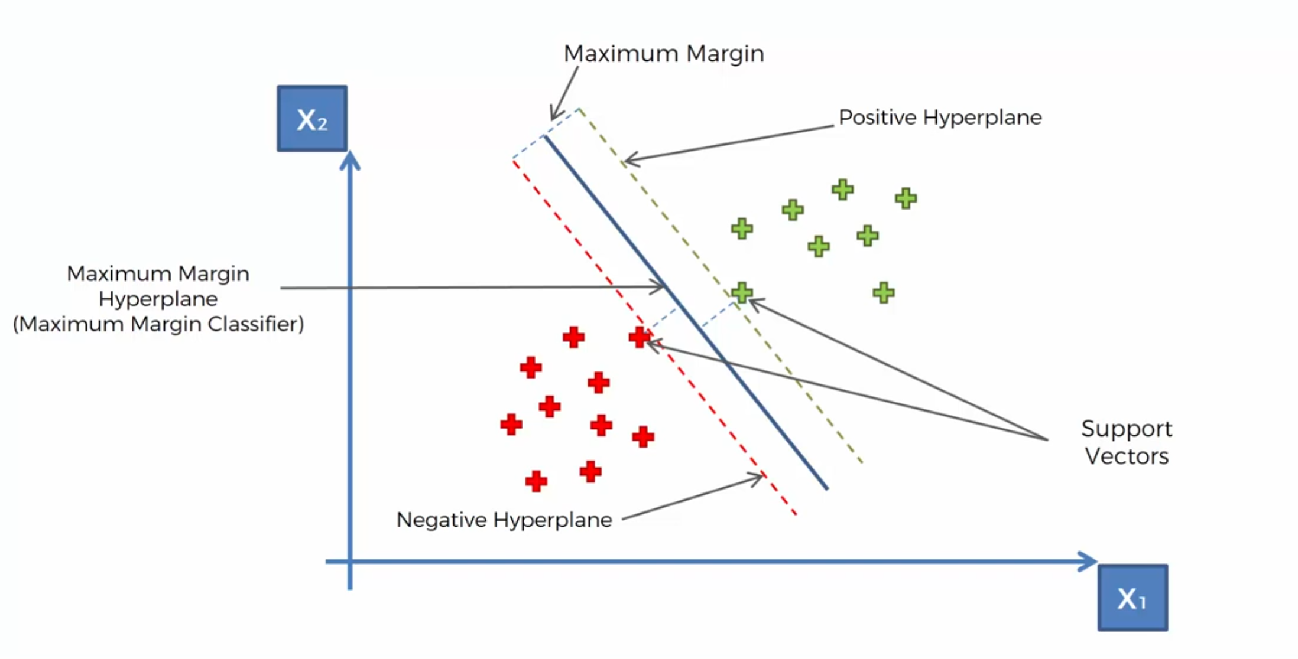
SVM

Slide 61
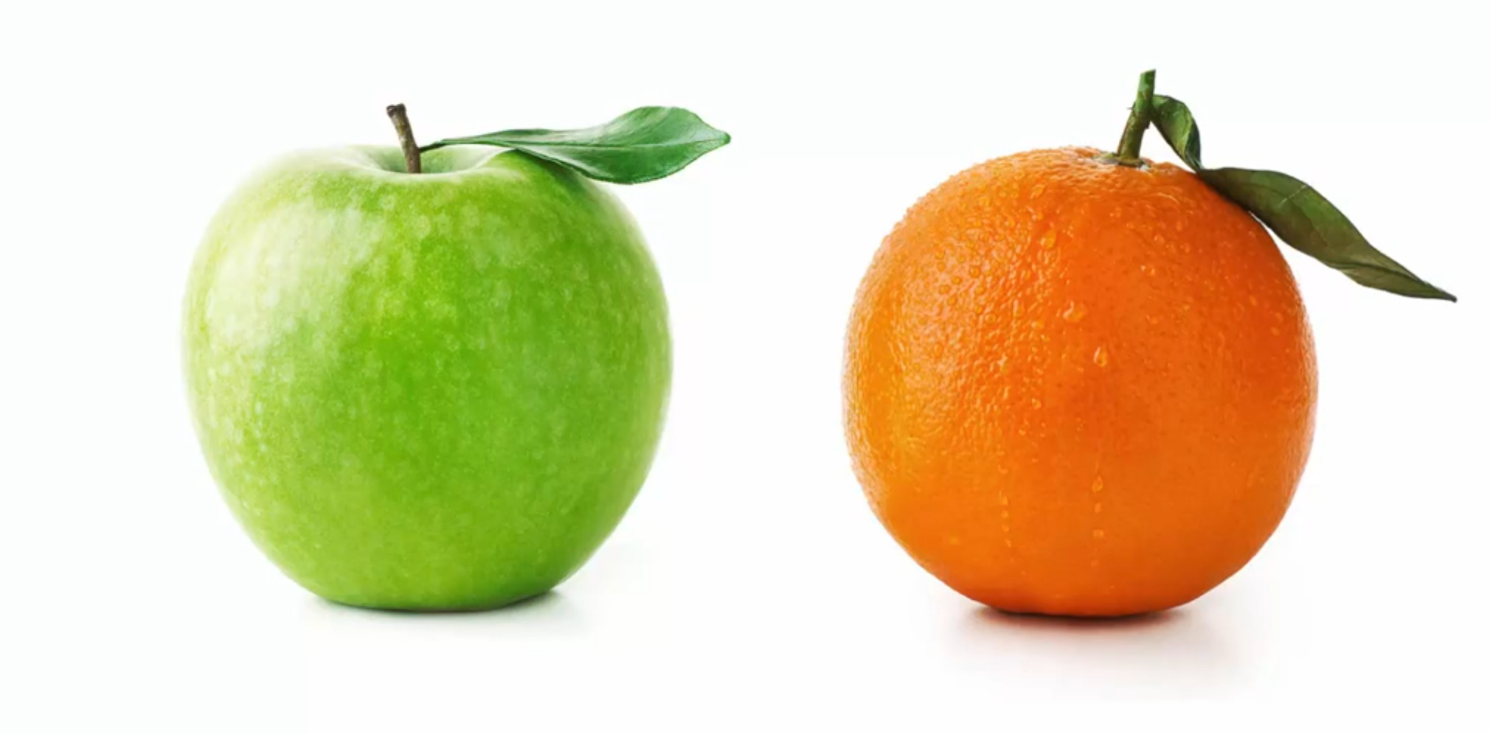
SVM

Slide 62
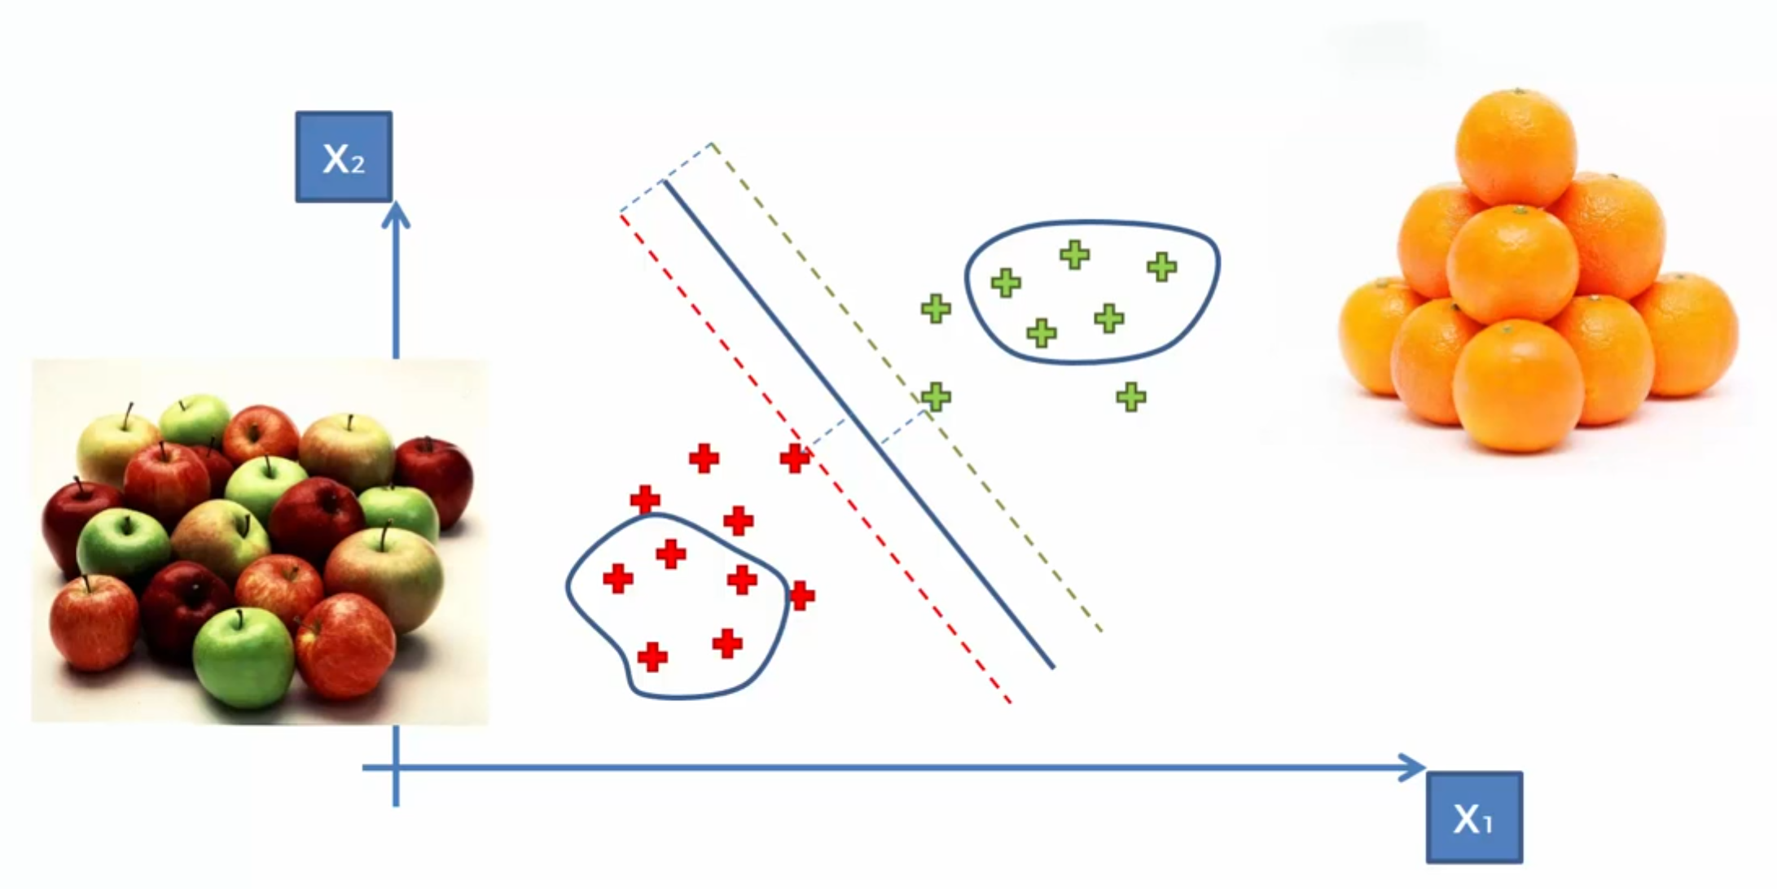
Most of the other ML models

Slide 63
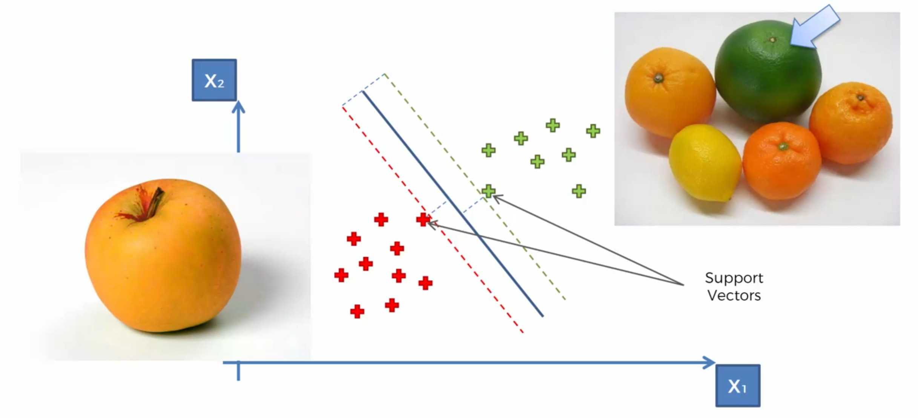
What is so special about SVMs?

Slide 64
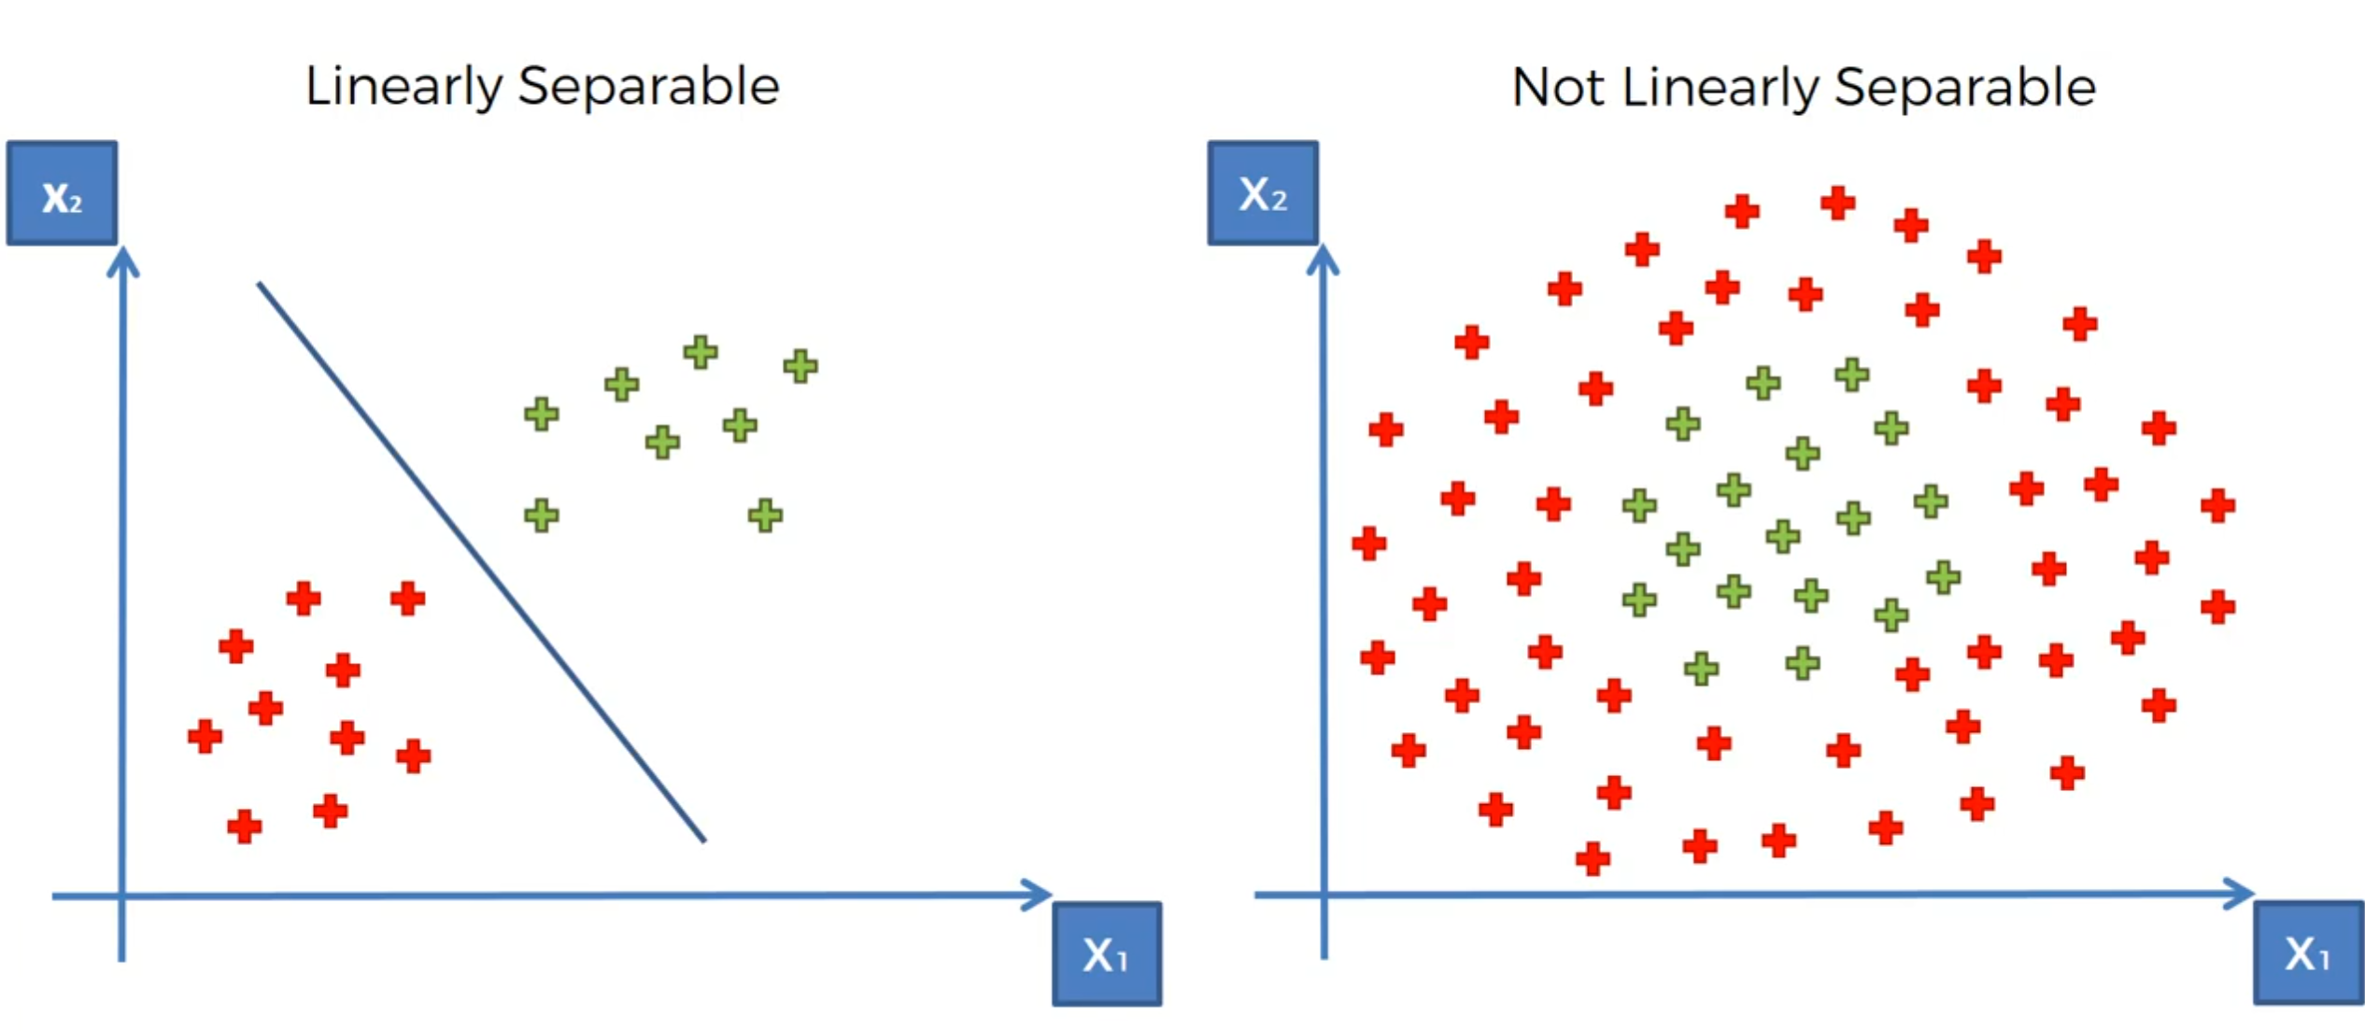
Linear Separability

Slide 65
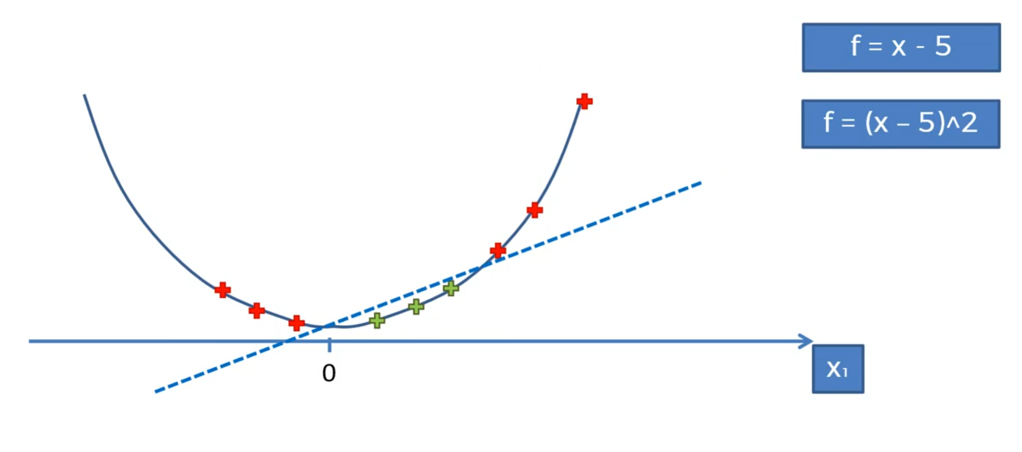
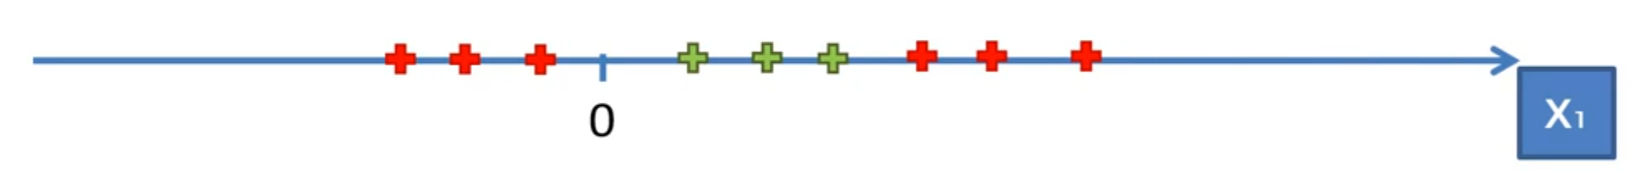
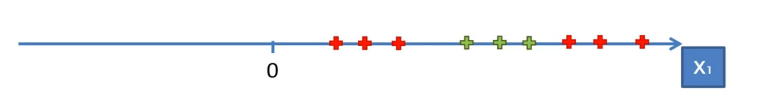
Mapping to Higher Dimension

Slide 66
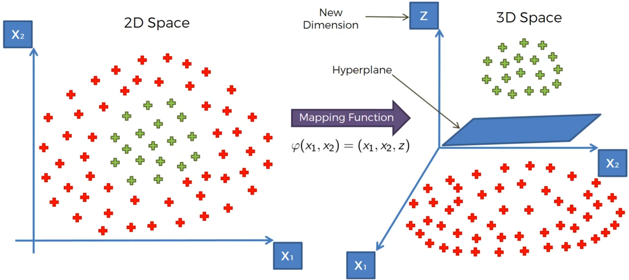
Mapping to Higher Dimension

Slide 67
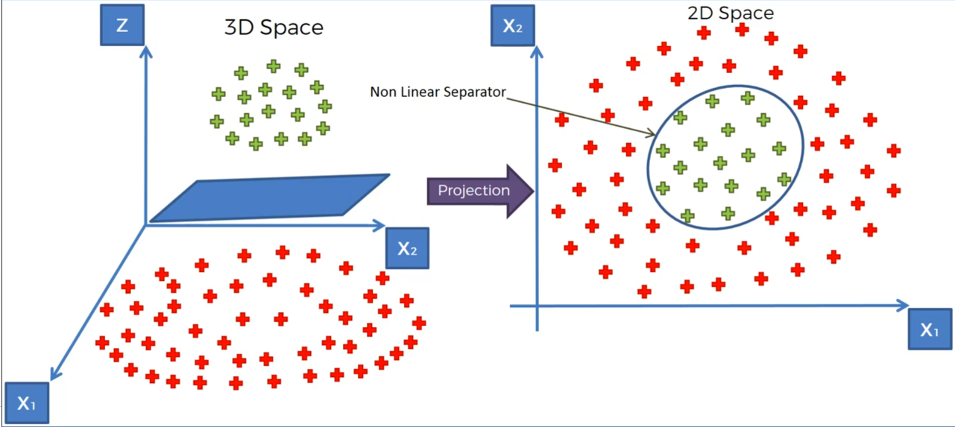
Projecting back to 2D space
Notes:
Bringing to Higher Dimension may need huge processing

Slide 68
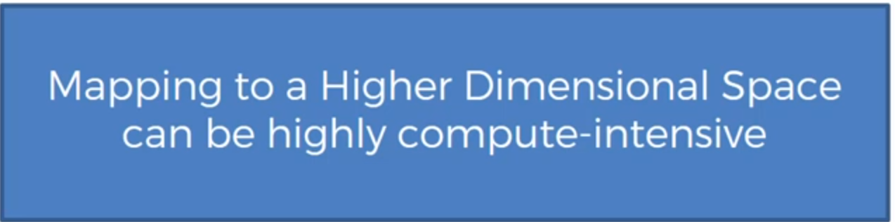

Slide 69
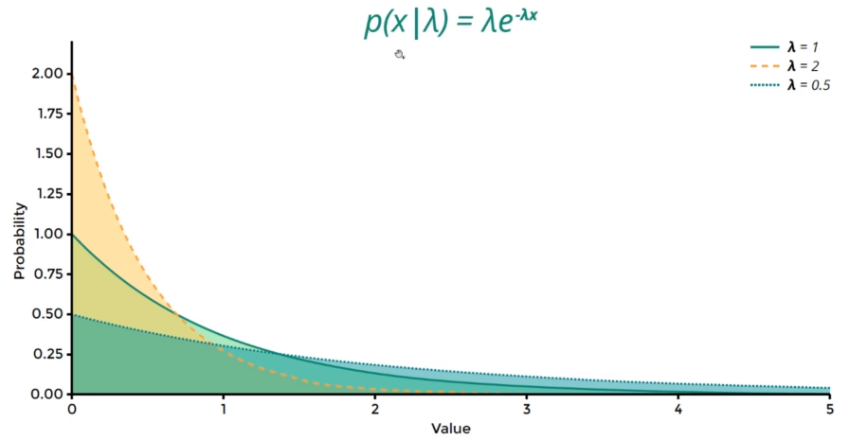
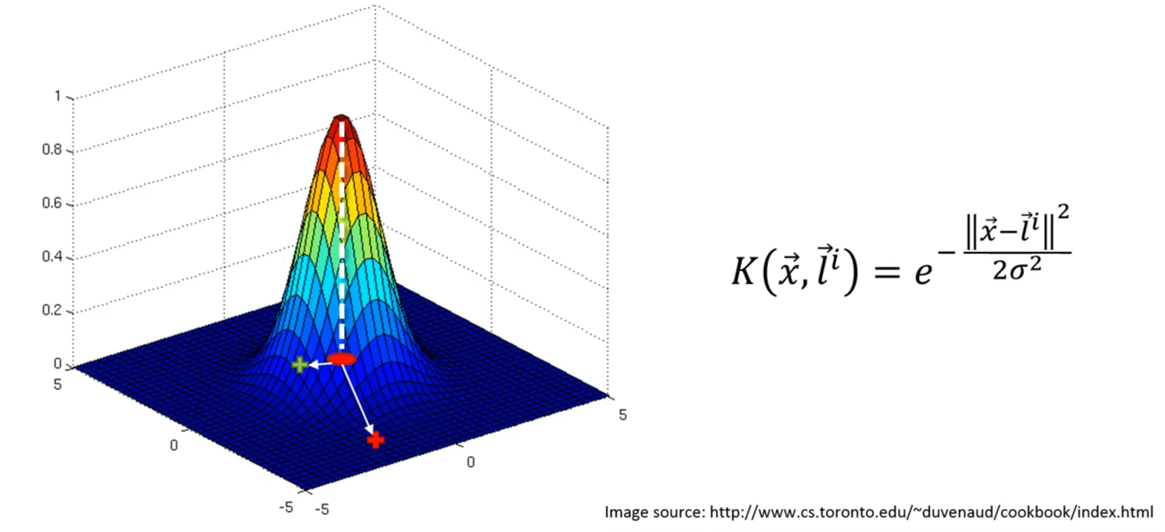
The Kernel Trick
The Gaussian RBF Kernel
Notes:
L is landmark in the above formula, RBF stands for Radial Basis Function Kernel

Slide 70
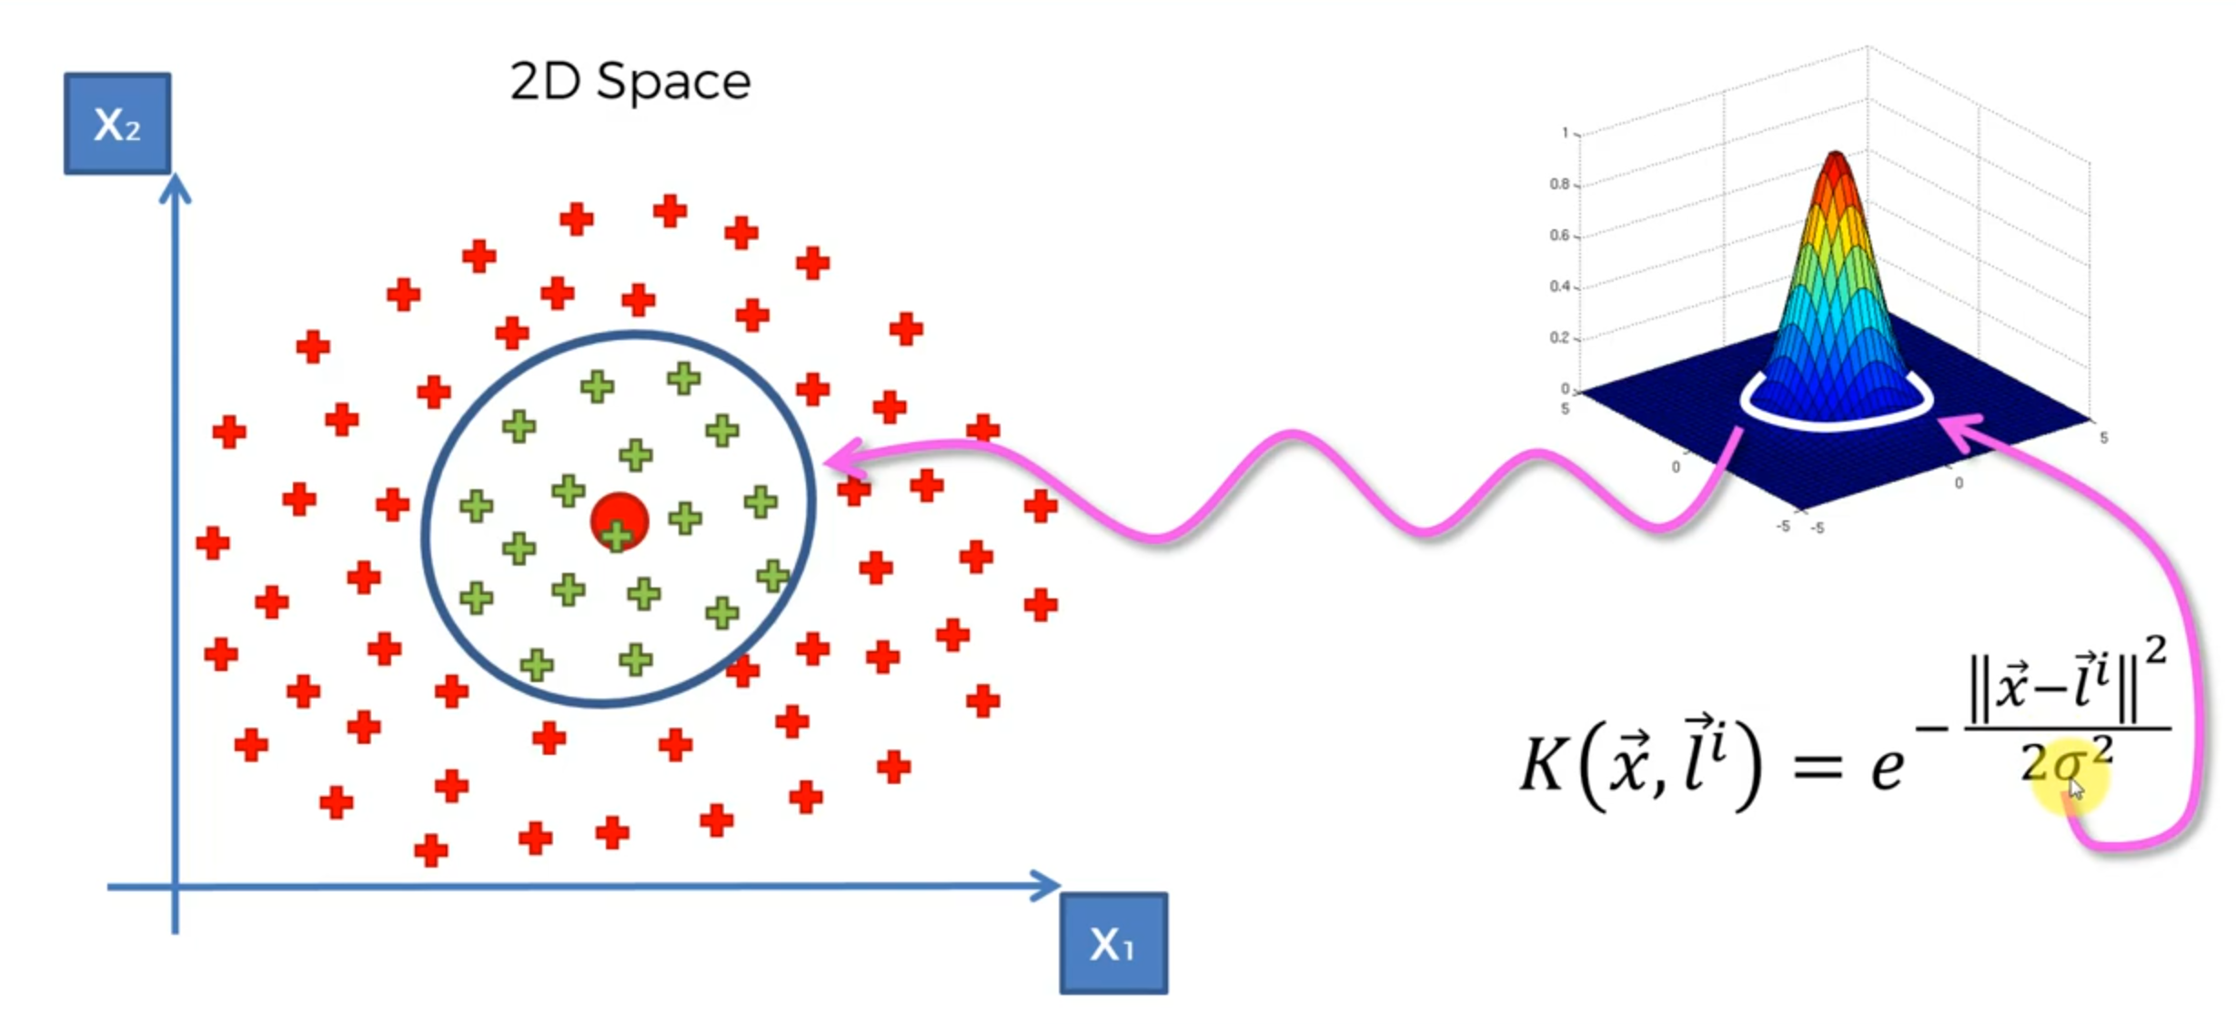
The Gaussian RBF Kernel

Slide 71
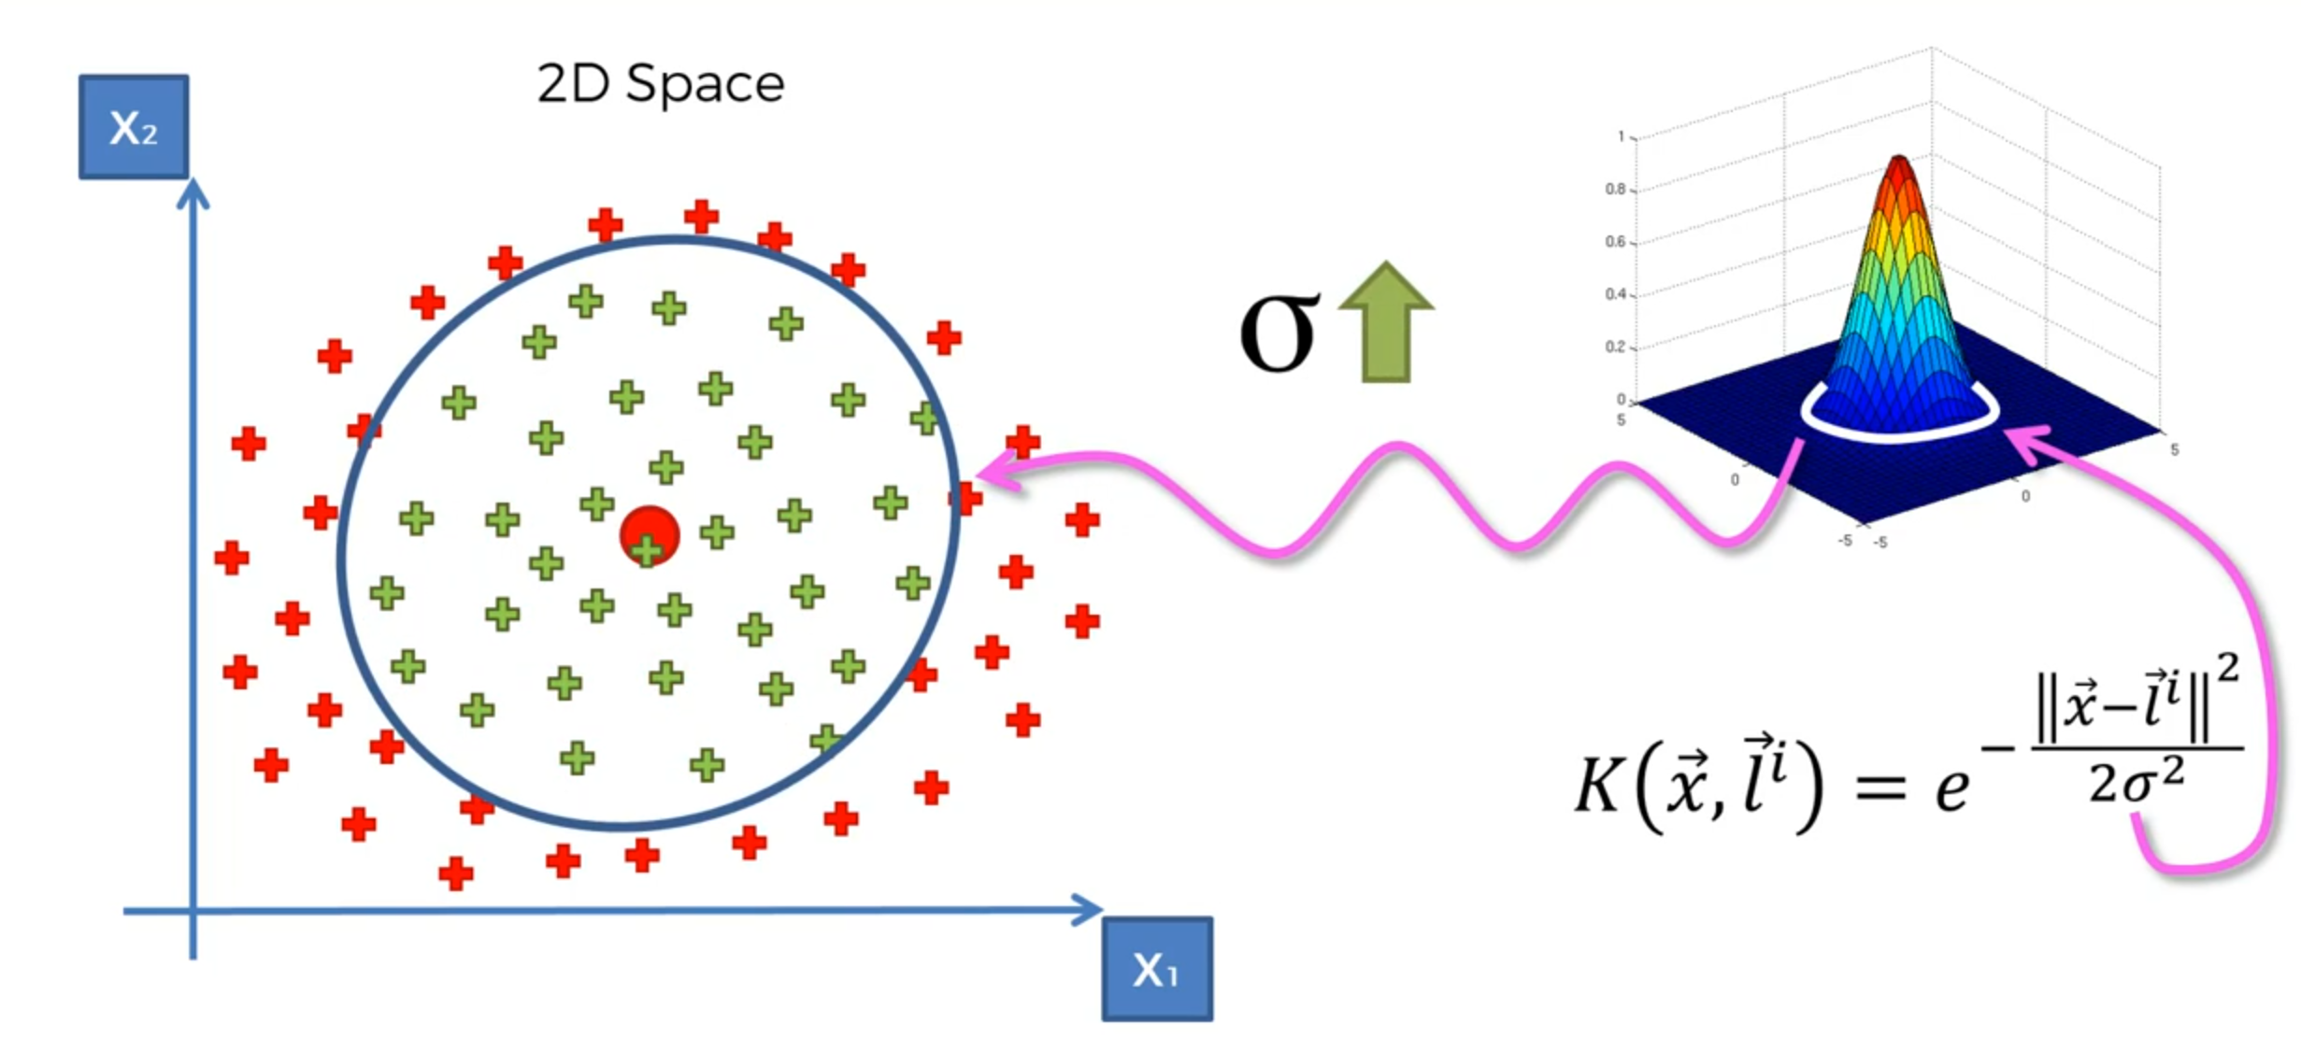
Increase the Sigma in Gaussian RBF Kernel

Slide 72
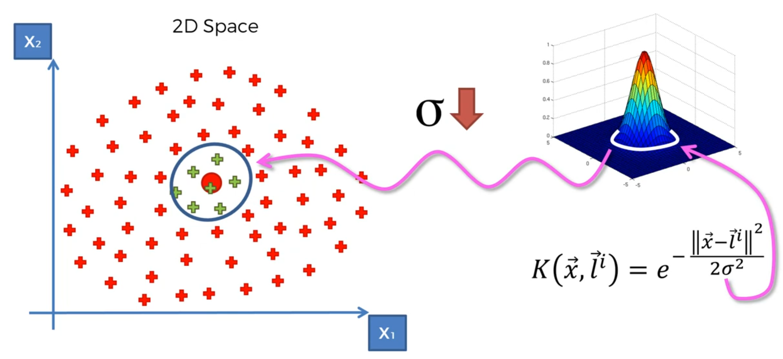
Decrease the Sigma in Gaussian RBF Kernel

Slide 73

More Complex Gaussian RBF Kernel

Slide 74

Different Type of Kernel Function

Slide 75

Naïve Bayes - Bayes' theorem
For each data point, what is the probability to be in each class, then we select the one which is bigger!
Notes:
W

Slide 76

Naïve Bayes - Bayes' theorem

Slide 77

Naïve Bayes - Bayes' theorem

Slide 78


Slide 79


Slide 80


Slide 81



Slide 82


Slide 83


Slide 84
Random Forest

Slide 85


Slide 86


Slide 87
Evaluation Models
https://towardsdatascience.com/various-ways-to-evaluate-a-machine-learning-models-performance-230449055f15
https://towardsdatascience.com/understanding-the-confusion-matrix-and-how-to-implement-it-in-python-319202e0fe4d
Regression
MSE
RMSE
Classification
Confusion Metrix
Accuracy
Precision
Recall
F1 Score
ROC_AUC

Slide 88

Evaluating Classification Models

Slide 89

Confusion Matrix

Slide 90

Why Accuracy is not enough?

Slide 91

Why Accuracy is not enough?

Slide 92


Cumulative Accuracy Profile
Notes:
Assumption for a given shop:
100K Customer
10% percent of the ad. random email will be a purchase

Slide 93

Cumulative Accuracy Profile

Slide 94


Model Rate!

Slide 95
Cross Validation

Slide 96


Slide 97


Slide 98


Slide 99


Slide 100


Slide 101


Slide 102


Slide 104
Unsupervised Learning or Clustering
K-Means Algorithm and HC

Slide 105


Slide 106


Slide 107


Slide 108


Slide 111
K-Means

Slide 112


Slide 113
K-MEANS Clustering Algorithm
Choose the number K of clusters
Select at random K points, the centroids (not necessarily from your dataset)
Assign each data point to the closest centroid-->> that forms K clusters
Compute and place the new centroid of each cluster
Reassign each data point to the new closest centroid.
If any reassignment took place, go to STEP 4, otherwise go to FIN.
YOUR MODEL IS READY

Slide 114


Slide 115


Slide 117


Slide 118


Slide 119


Slide 120


Slide 121


Slide 122


Slide 123


Slide 124


Slide 125


Slide 126


Slide 127


Slide 128


Slide 129










Slide 130
Trap Example

Slide 131


Slide 132


Slide 133


Slide 134
How many Number of Cluster?

Slide 135


Slide 136


Slide 137


Slide 138


Slide 139
Hierarchical Clustering

Slide 140


Slide 141


Slide 142


Slide 143


Slide 144


Slide 145


Slide 146


Slide 147


Slide 148


Slide 149


Slide 150


Slide 151


Slide 152


Slide 153


Slide 154


Slide 155


Slide 156


Slide 157


Slide 158


Slide 159


Slide 160


Slide 161


Slide 162


Slide 163


Slide 164


Thank You
Abbas Malekpour
Abbas.malekpour@gmail.com

